Slide 1



Welcome!
Please download all of the course material:
Do you have a github account? Give us a star! :)
and store it in a single, accessible folder on your computer. Don’t forget to unzip!
tinyurl.com/introRData > >

Slide 2
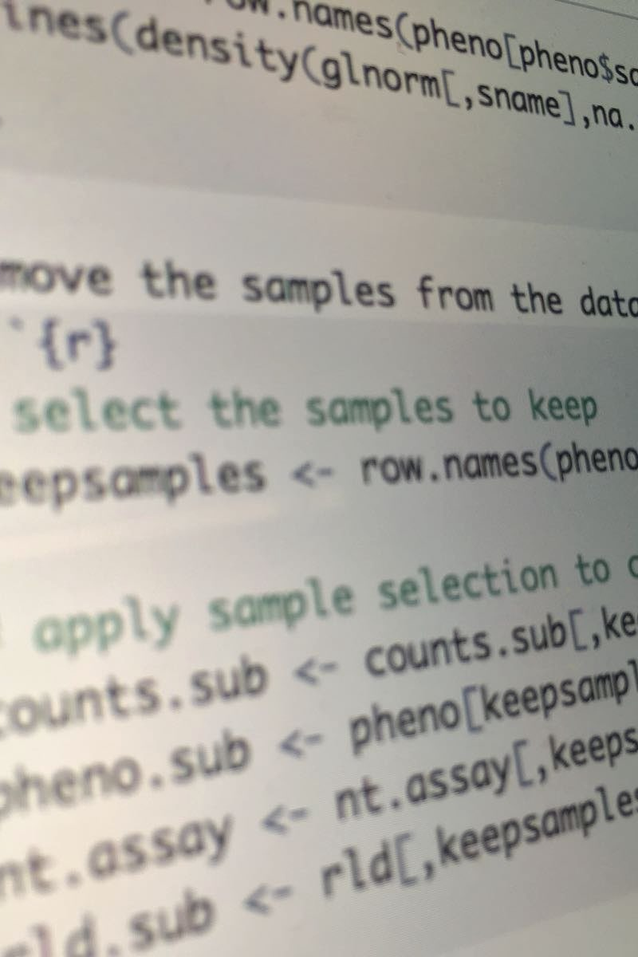
Introduction to R & data
Part I: Basics of R
Lunch (~12:15)
Part II: Modern R with tidyverse
Final remarks (~17:00)

Slide 3
Quick intro: this is us! And who are you?
Bianca Kramer
subject specialist Biomedical Science
UU Library
b.m.r.kramer@uu.nl
Barbara Vreede
subject specialist Science
UU Library
b.m.i.vreede@uu.nl

Slide 4
What’s with those sticky notes?
I need some assistance, please!
I have finished the exercise and am ready to move on!
No sticky note?

Slide 5
Introduction to R & data
Part 1: Basics of R

Slide 6
What is R?
Widely used programming language for data analysis
Based on statistical programming language S (1976)
Developed by Ross Ihaka & Robert Gentleman (1995)
Very active community, with many (often subject-specific) packages

Slide 7
We will work in RStudio
Integrated Development Environment for R
Founded by JJ Allaire, available since 2010
Bloody useful! Let’s take a look: please open RStudio!

Slide 8
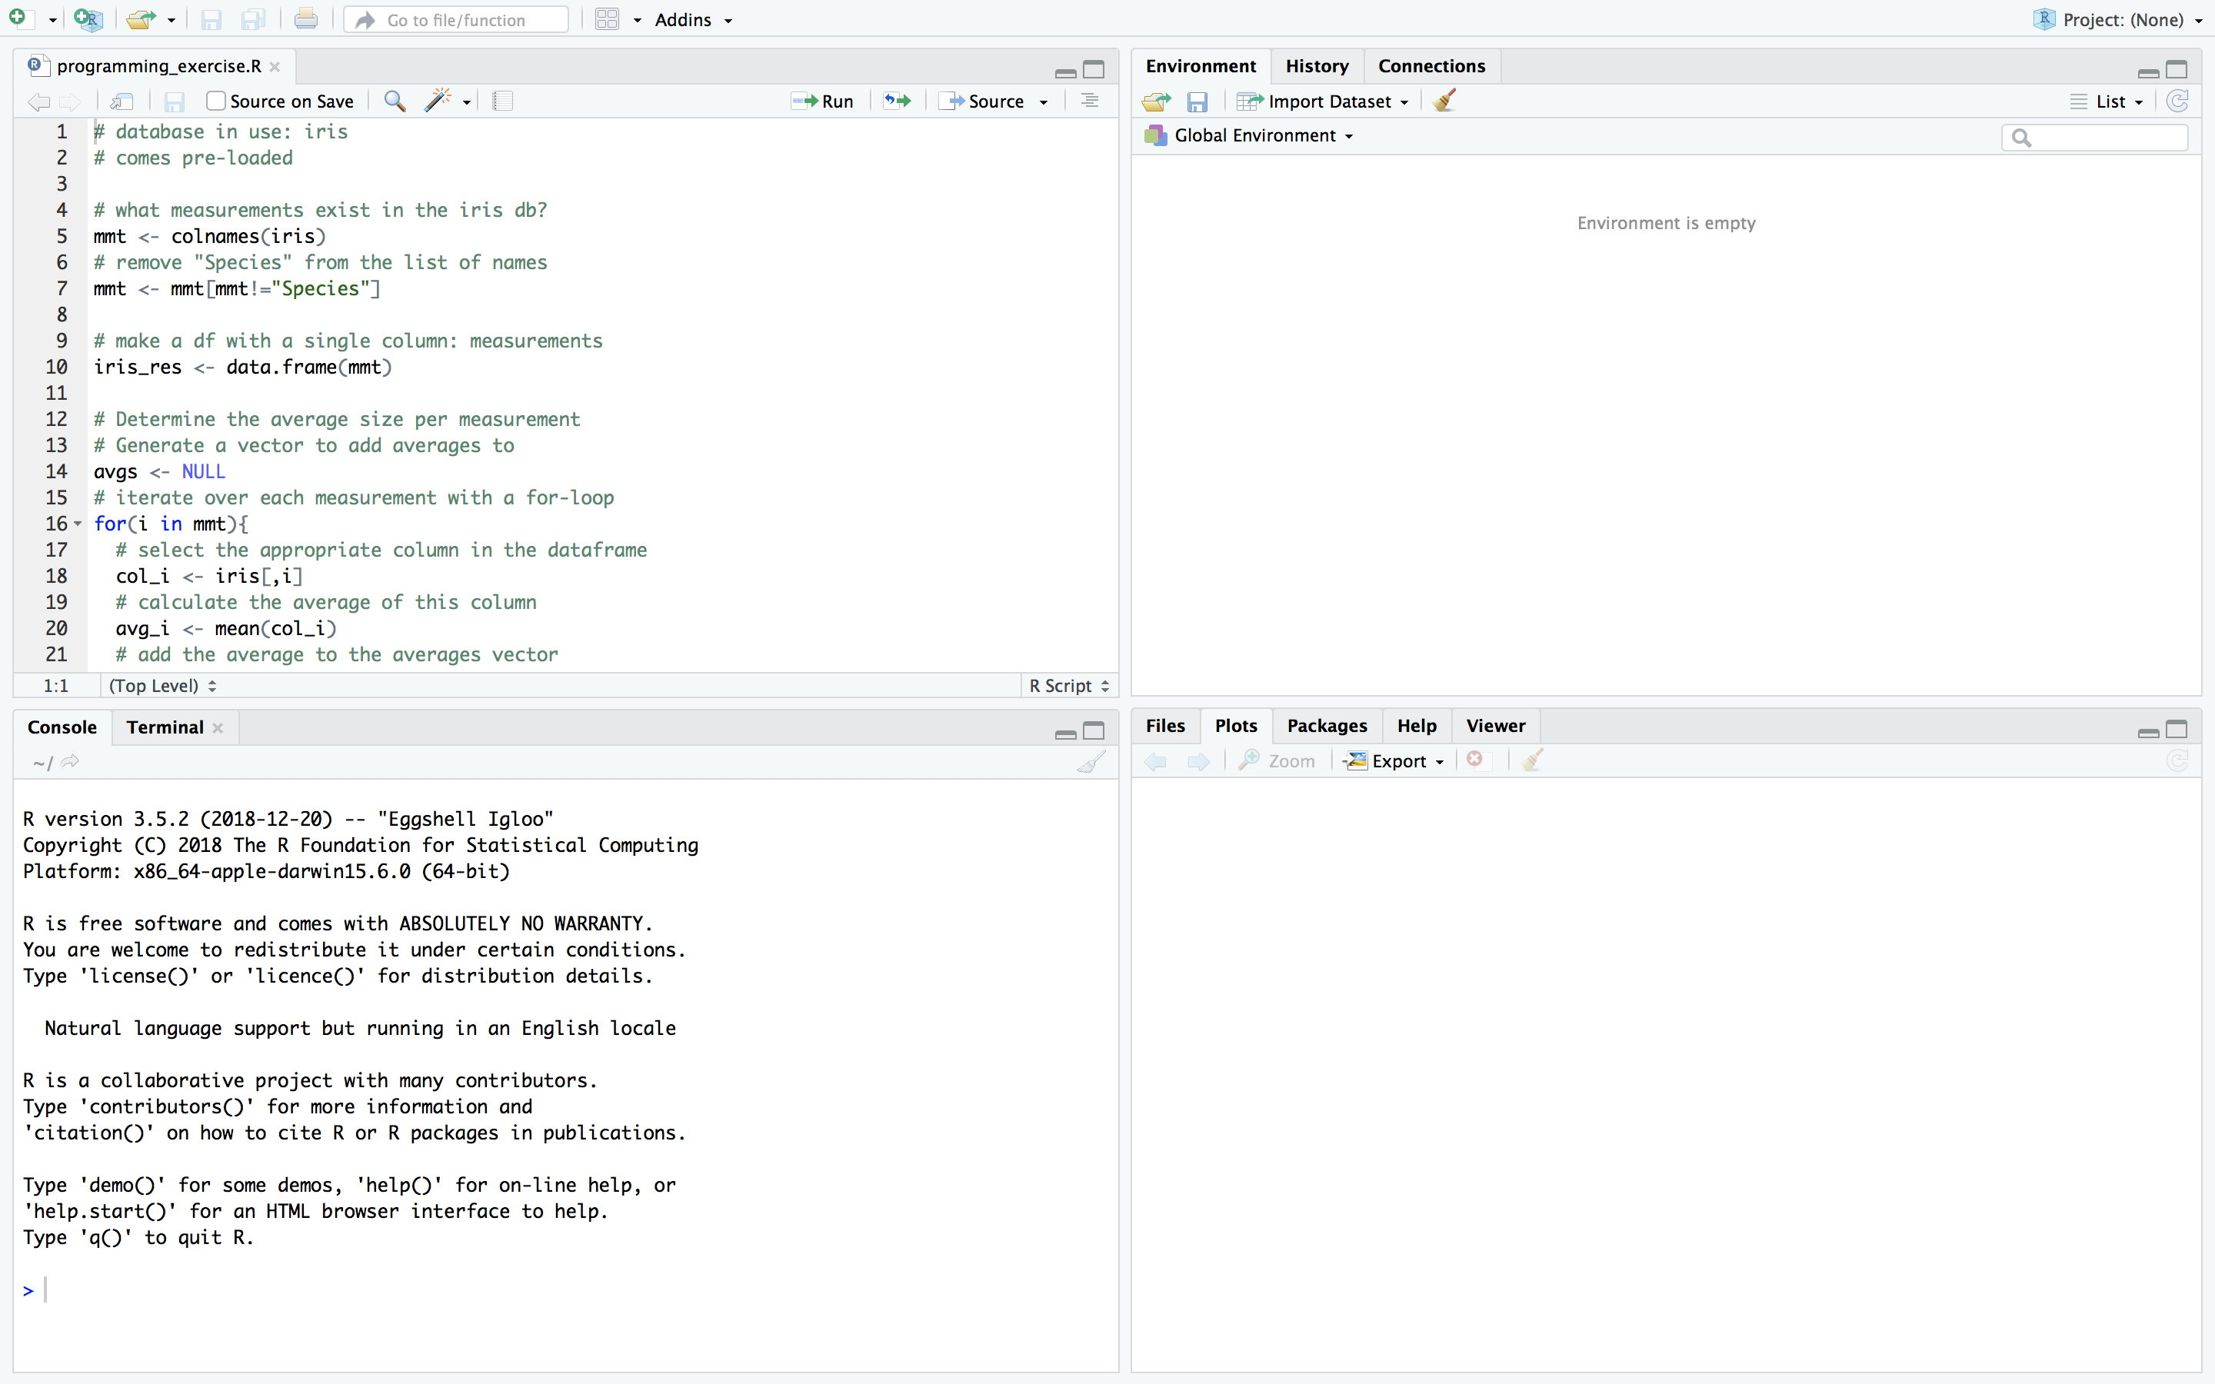
The Rstudio interface
script
markdown
data preview
environment
history
console
files
plots
packages
help

Slide 9
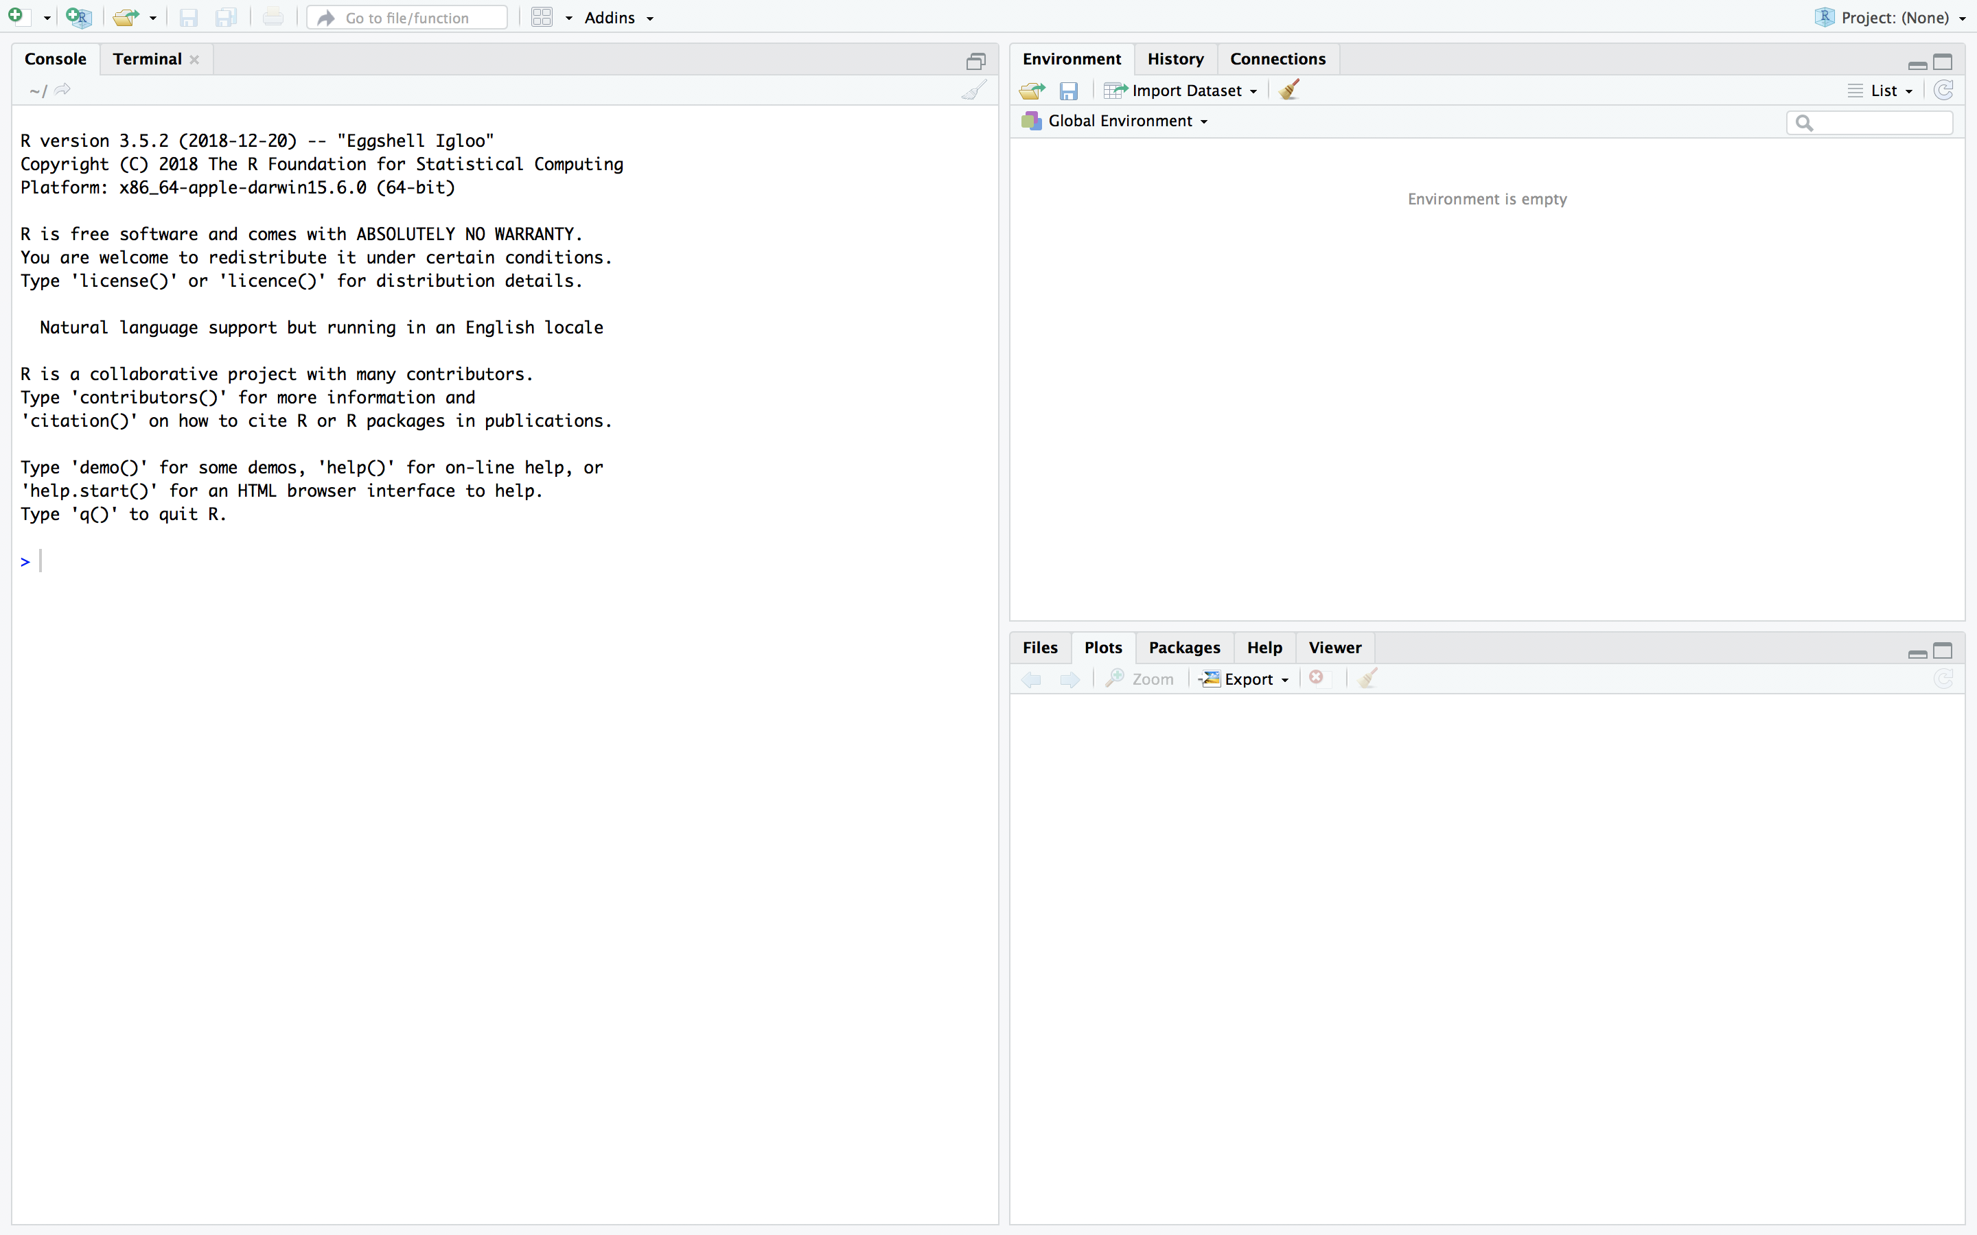
The Rstudio interface
console
environment
history
files
plots
packages
help

Slide 10
Have you downloaded the course material?
Please store it in a single, accessible folder on your computer. Don’t forget to unzip!
tinyurl.com/introRData > >

Slide 11
R syntax & the console
Data types in R
Combining data
First functions

Slide 12
A quick note on notes
The console is for execution, not for storage
Everything we do is on the slides!
BUT: you can store, if you want, by copy-pasting to a text document
Do you want to write notes in between?
# write your notes in the console like this
# using a #hash sign.
# pressing enter will do nothing.
# go ahead and try!

Slide 13
Variable assignment
>

Slide 14
Variable assignment
> x <- 6

Slide 15
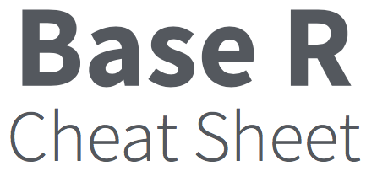
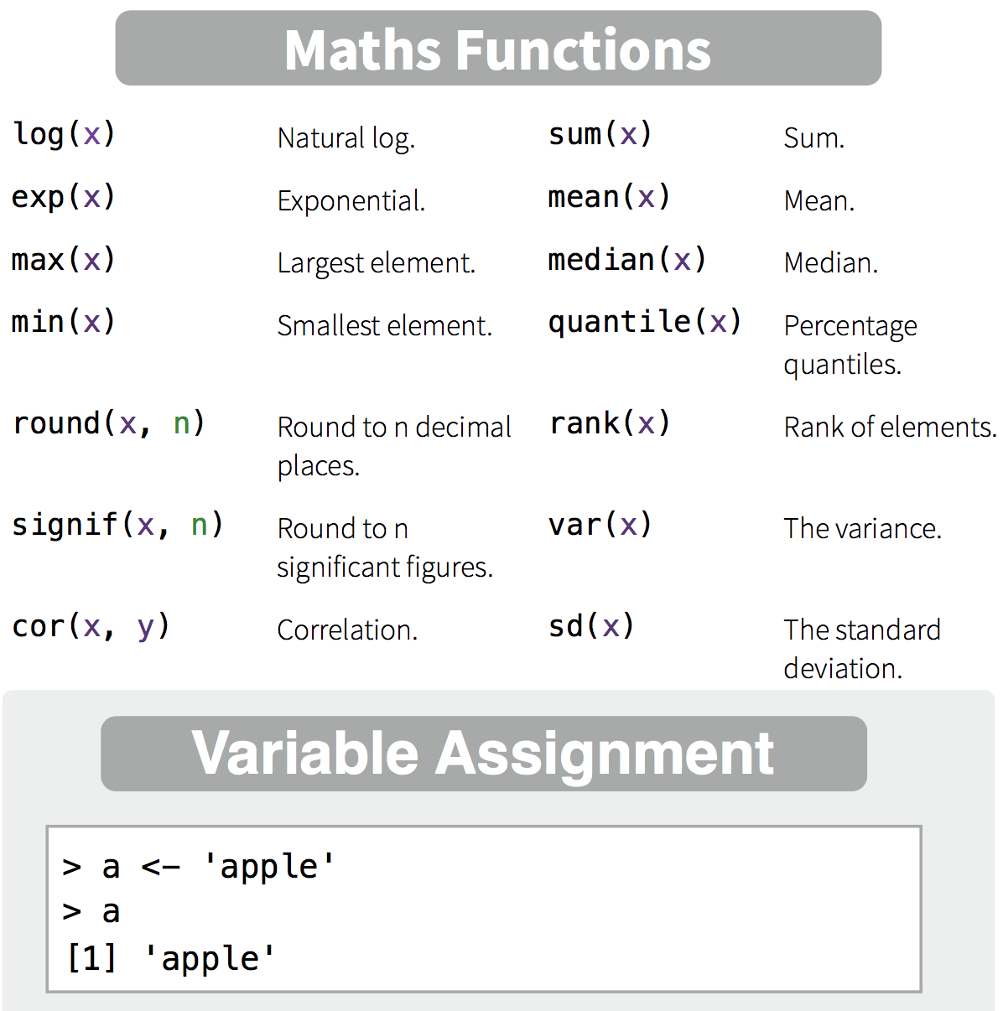
Variable assignment
> x <- 6
> x <- "hi!"
> 6 -> x
> x = 6
> 6 = x
Error in 6 = x : invalid (do_set) left-hand side to assignment

Slide 16
Maths Functions
> x * 3
[1] 18
> y <- x + 2
> log2(y)
[1] 3
Notes:
We can assign values to variables, both numeric and character
We can perform mathematical operations
More complex mathematical operations can be performed using functions.
See your cheatsheet!
You will see that most of these are not operations you can perform on a single number (mean, sum, max, etc). For that, we need another data type.

Slide 17
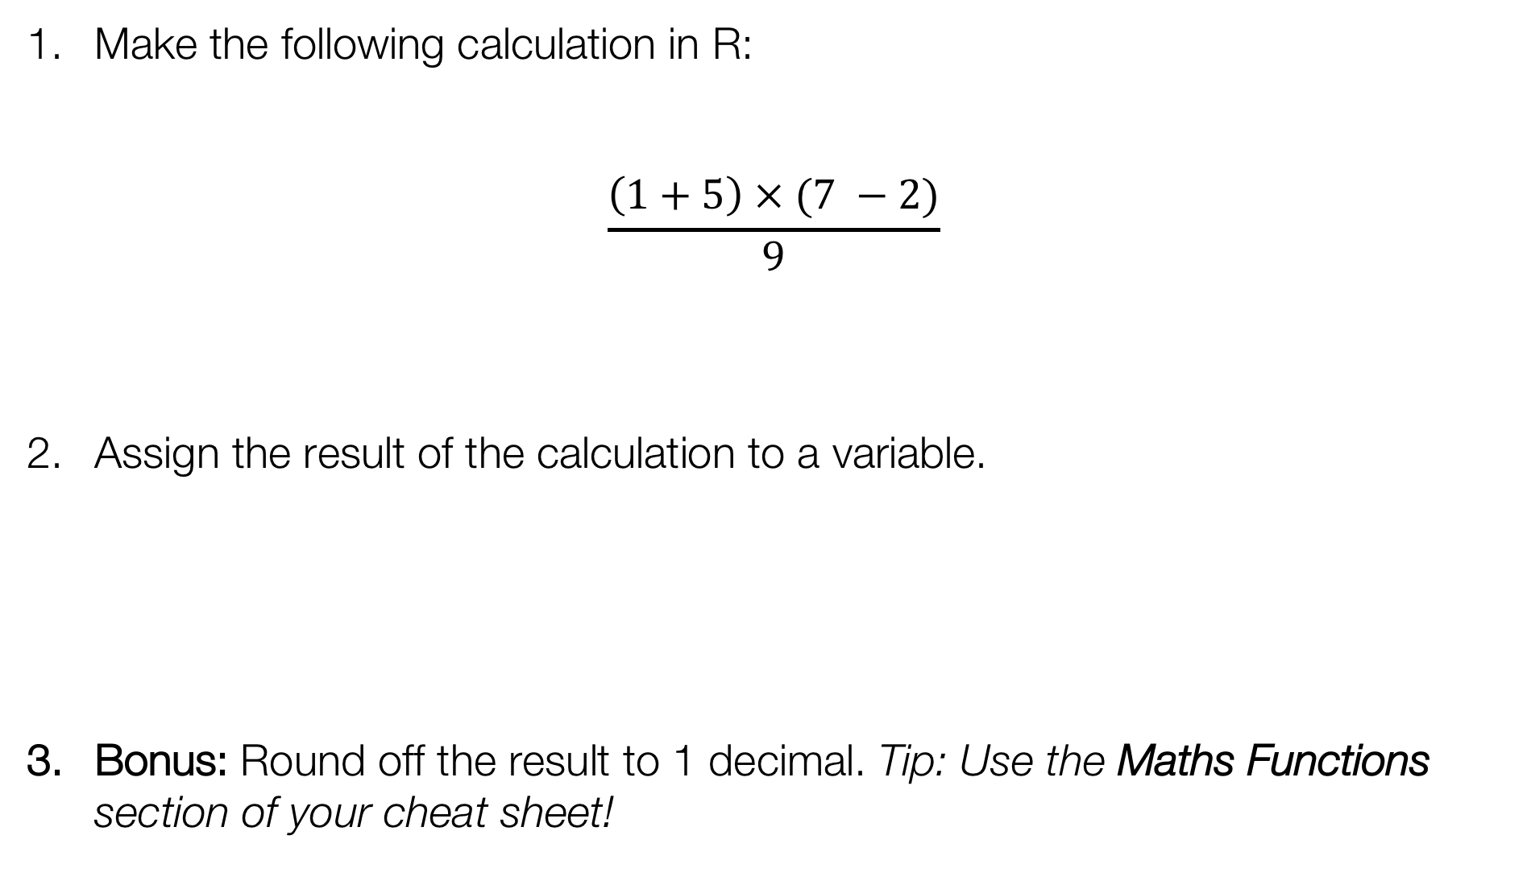
Exercise
Make the following calculation in R:
$$\frac{\left(1+5\right) × (7 −2)}{9}$$
Assign the result of the calculation to a variable.
Bonus: Round off the result to 1 decimal. Tip: Use the Maths Functions section of your cheat sheet!

Slide 18
Exercise
Make the following calculation in R:
$$\frac{\left(1+5\right) × (7 −2)}{9}$$
Assign the result of the calculation to a variable.
Bonus: Round off the result to 1 decimal. Tip: Use the Maths Functions section of your cheat sheet!
> ((1+5)*(7-2))/9
> MyCalc <- ((1+5)*(7-2))/9
> round(MyCalc,1)

Slide 19
Another data type: logical
T | TRUE
F | FALSE
> T
[1] TRUE
> 1==1
[1] TRUE
> 2!=4
[1] TRUE
== is equal to
!= is not
>= larger than or equal to
< smaller than

Slide 20
Combining data: creating vectors
> c(1,2,3)
[1] 1 2 3
> c("a","b","c")
[1] "a" "b" "c"
> c(T,TRUE,F)
[1] TRUE TRUE FALSE
a numeric vector
a character vector
a logical vector

Slide 21
Vector functions
> p <- 1:5
> p
[1] 1 2 3 4 5
> mean(p)
[1] 3
> p * 2
[1] 2 4 6 8 10
> q <- 5:1
> p * q
[1] 5 8 9 8 5
> table(p*q)
5 8 9
2 2 1
p * 2
p | 2
1 | 2 | 2
2 | 2 | 4
3 | 2 | 6
4 | 2 | 8
5 | 2 | 10
p * q
p | q
1 | 5 | 5
2 | 4 | 8
3 | 3 | 9
4 | 2 | 8
5 | 1 | 5

Slide 22
Exercise
Make the following vector using seq():
[1] 8 10 12 14
Make another vector using rep():
[1] 7 7 7 7
Combine all three functions c(), rep(), and seq() to generate this vector:
> MyVec <- ...
> MyVec
[1] 12 12 12 4 5 6
Bonus: can you sort the values in the last vector from low to high?

Slide 23
Exercise
Make the following vector using seq():
> seq(8,14, by=2)
[1] 8 10 12 14
Make another vector using rep():
> rep(7,4)
[1] 7 7 7 7
Combine all three functions c(), rep(), and seq() to generate this vector:
> MyVec <- c(rep(12,3),seq(4,6))
> MyVec
[1] 12 12 12 4 5 6
Bonus: can you sort the values in the last vector from low to high?
> sort(MyVec)

Slide 24
Vectors and factors
> chars <- c("a","b","a","c")
> chars
[1] "a" "b" "a" "c"
> F_chars <- as.factor(chars)
> F_chars
[1] a b a c
Levels: a b c
> as.character(F_chars)
[1] "a" "b" "a" "c"

Slide 25

Vectors and factors
> nums <- 10:13
> nums
[1] 10 11 12 13
> F_nums <- as.factor(nums)
> F_nums
[1] 10 11 12 13
Levels: 10 11 12 13
> as.numeric(F_nums)
[1] 1 2 3 4
A factor is defined by its levels. Turning a factor into numeric specifies the order of the levels, but loses their content.

Slide 26
Exercise
1. Generate a vector that contains numeric, logical, and character elements.
> vt <- ...
2. Turn it into a factor.
> ft <- ...
3. See what happens to the content when you convert this factor into numeric, logical, and character vectors.
(Hint: check the cheat sheet element ‘Types’ for the functions.)

Slide 27
Exercise
1. Generate a vector that contains numeric, logical, and character elements.
> vt <- c(T,T,2,4,"apple","orange")
2. Turn it into a factor.
> ft <- as.factor(vt)
3. See what happens to the content when you convert this factor into numeric, logical, and character vectors.
(Hint: check the cheat sheet element ‘Types’ for the functions.)
> as.numeric(ft)
[1] 5 5 1 2 3 4
> as.logical(ft)
[1] TRUE TRUE NA NA NA NA
> as.character(ft)
[1] "TRUE" "TRUE" "2" "4" "apple" "orange"

Slide 28

But what if there is no data? Introducing: NA
> ft <- c(T,T,2,4,"apple","orange")
> ft <- as.logical(ft)
> ft
[1] TRUE TRUE NA NA NA NA
> factor(ft)
[1] TRUE TRUE <NA> <NA> <NA> <NA>
Levels: TRUE
NA = Not Available
Name | Age | Pet
Ann | 33 | Cat
Bob | 25 | None
Chloe | 21 | Iguana
Dan | 45 | NA
In other words:
We know that Bob has no pets.
We do not know if Dan has pets.

Slide 29
Exercise: predict the answer
> NA == NA
Predict the results. Does the (real) answer make sense to you?

Slide 30
Exercise: predict the answer
> NA == NA
[1] NA
Predict the results. Does the (real) answer make sense to you?
> is.na(NA)
[1] TRUE

Slide 31

NA != NULL
NA
NULL
“None” or 0
Information is Not Available
Information does not exist
Data entry specifying content of 0
Notes:
It's like determining whether there is coffee or tea in cup. None, there is nothing in the cup. NA we don't know what's in there. NULL, there isn't even a cup (we can't put something in there at all).

Slide 32
Exercise: predict the answer
> is.na(NA)
[1] TRUE
> is.null(NULL)
[1] TRUE
Predict the results. Does the (real) answer make sense to you?
> is.null(NA)
> is.na(NULL)

Slide 33
Exercise: predict the answer
> is.na(NA)
[1] TRUE
> is.null(NULL)
[1] TRUE
Predict the results. Does the (real) answer make sense to you?
> is.null(NA)
[1] FALSE
> is.na(NULL)

Slide 34
Exercise: predict the answer
> is.na(NA)
[1] TRUE
> is.null(NULL)
[1] TRUE
Predict the results. Does the (real) answer make sense to you?
> is.null(NA)
[1] FALSE
> is.na(NULL)
[1] logical(0)

Slide 35
Vectors, lists, and data frames
> v1 <- 4:6
> v2 <- rep(3,3)
> c(v1,v2)
[1] 4 5 6 3 3 3
> list(v1,v2)
[[1]]
[1] 4 5 6
[[2]]
[1] 3 3 3
> data.frame(v1,v2)
v1 v2
1 4 3
2 5 3
3 6 3
 | how many dimensions? | function
vector | 1 | c()
list | any number | list()
data frame | 2 | data.frame()

Slide 36
Let’s breathe and recap!
What data types have you encountered so far?
logical
numeric
character
How can data be absent?
NA (not available)
NULL (non-existent)
And what data collections have you encountered?
vector (one dimension)
factor (one dimension, level-based)
data frame (two dimensions)
list (++ dimensions)

Slide 37
Functions
What functions have you encountered so far?
> c()
> rep()
> as.logical()
> data.frame()
> is.na()
> table()
...
And do you still know what they mean? And how to use them? No?
> ?table()
> help.search("standard deviation")
(or use the Help window to the right of your console)

Slide 38
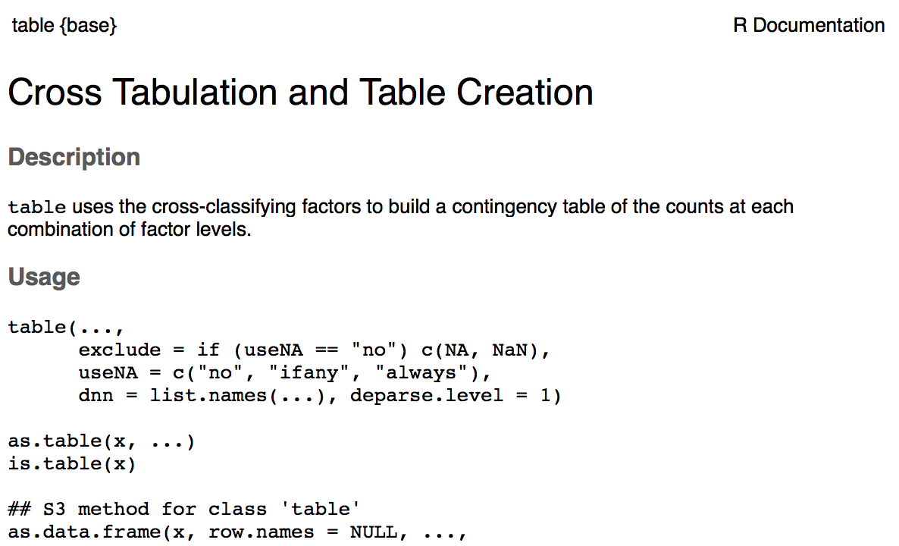
Help!
function & package names
wait what? These are extra arguments. If you see
argument = "default"
then the setting is already specified, so you won’t have to.
how would you use the function?
functions so related they share a help page

Slide 39
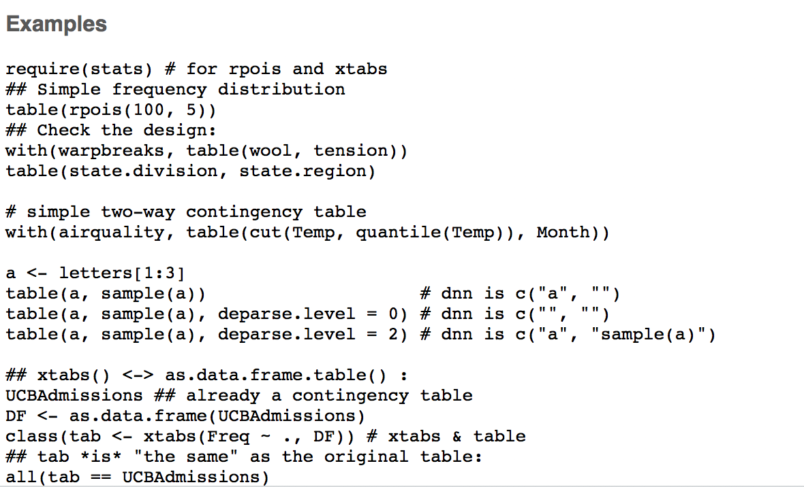
Help? Scroll down!

Slide 40
Take a break!
"Fresh Cup" by mikecpeck

Slide 41
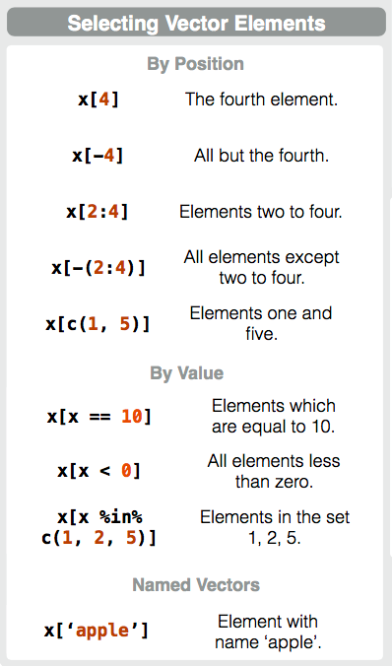
Selecting vector elements by position
> m <- 8:4
> m
[1] 8 7 6 5 4
> m[2]
[1] 7
> m[1:3]
[1] 8 7 6

Slide 42
Selecting vector elements by value
m | m>5 | result
8 | TRUE | 8
7 | TRUE | 7
6 | TRUE | 6
5 | FALSE
4 | FALSE
> m <- 8:4
> m
[1] 8 7 6 5 4
> m[m>5]
[1] 8 7 6
> m>5
[1] TRUE TRUE TRUE FALSE FALSE
> m[m %in% c(6,8,11)]
[1] 8 6
> m[NA]
[1] NA NA NA NA NA

Slide 43
Exercise
Generate a vector with numbers from 5 to 10.
(If you can, try to use vector notation p:q or the function seq() for this!)
> m <- ...
Return only the 2nd and 4th number in the vector.
> m[...]
Return only numbers larger than 8.
> m[...]

Slide 44
Exercise
Generate a vector with numbers from 5 to 10.
(If you can, try to use vector notation p:q or the function seq() for this!)
> m <- 5:10
Return only the 2nd and 4th number in the vector.
> m[c(2,4)]
Return only numbers larger than 8.
> m[m>8]

Slide 45
Indexing lists
> v1 <- 4:6
> v2 <- rep(3,3)
> mylist <- list(v1,v2)
> mylist[1]
[[1]]
[1] 4 5 6
> mylist[[1]]
[1] 4 5 6
> mylist[[1]][2]
[1] 5
> mylist[1][2]
[[1]]
NULL
select the first list element
select the content of the first list element

Slide 46
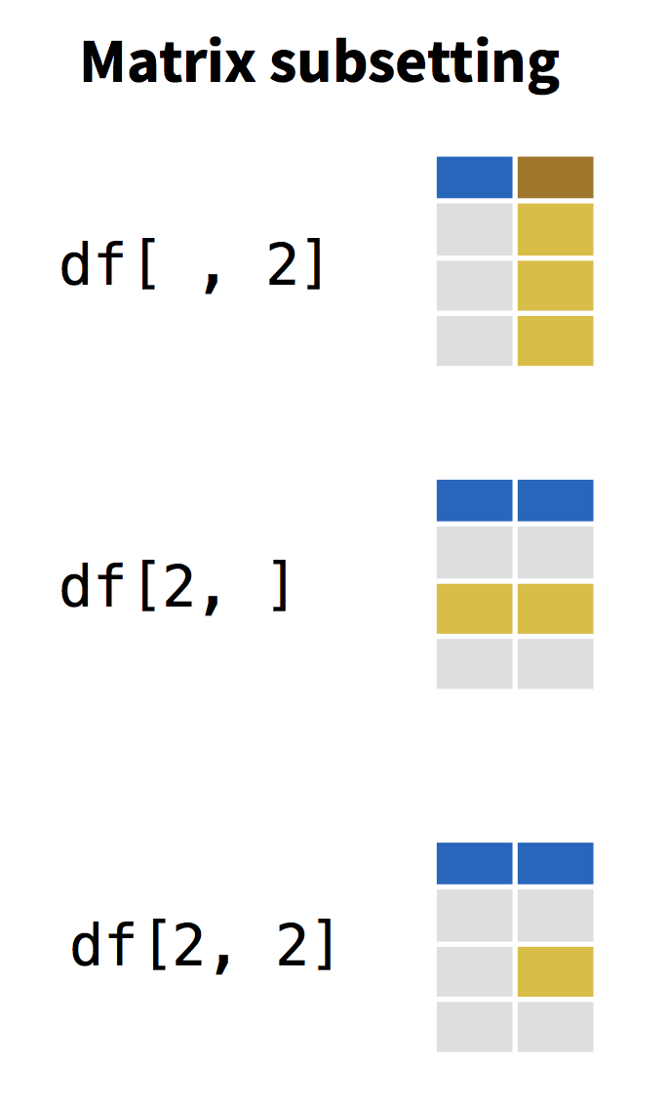


Indexing a data frame
name | age | pet
Ann | 33 | Cat
Bob | 25 | None
Chloe | 21 | Iguana
Dan | 45 | NA
row
column

Slide 47
Indexing a data frame
df[,2]
df[,"age"]
df$age
> df[,2]
[1] 33 25 21 45
> df[,"age"]
[1] 33 25 21 45
> df$age
[1] 33 25 21 45
> df[2,]
name age pet
2 Bob 25 None
> df[df$name=="Bob",]
name age pet
Bob 25 None
> df[df$name=="Bob","age"]
[1] 25
name | age | pet
Ann | 33 | Cat
Bob | 25 | None
Chloe | 21 | Iguana
Dan | 45 | NA
df[2,]
df[df$name=="Bob",]

Slide 48
Exercise
Generate a simple data frame like this:
> df <- data.frame(name=c("Ann","Bob","Chloe","Dan"),
age=c(33,25,21,45))
Return only the names of everyone in your data frame under 30.
(Hint: what information should you use for row indexing? What information should you use for column indexing?)
Bonus: can you use vector indexing on a column to achieve the same result?

Slide 49



Exercise
Generate a simple data frame like this:
> df <- data.frame(name=c("Ann","Bob","Chloe","Dan"),
age=c(33,25,21,45))
Return only the names of everyone in your data frame under 30.
(Hint: what information should you use for row indexing? What information should you use for column indexing?)
> df[df$age<30,"name"]
> df[df$age<30,1]
Bonus: can you use vector indexing on a column to achieve the same result?
> df$name[df$age<30]
[1] Bob Chloe
Levels: Ann Bob Chloe Dan
indexing the dataframe df
indexing the vector df$name

Slide 50
Which bracket does what?
[ ]
( )
{ }
Indexing vectors, lists, dataframes…
Passing arguments to functions
Defining content of loops, functions, etc.

Slide 51
Programming
Writing your first script
Programming with loops and functions
Handling and processing a dataset

Slide 52
Introducing a sample dataset
Dataset: ‘iris’
Standard dataset in R, measurements on 3 species of iris flowers
Iris setosa
Iris versicolor
Iris virginica

Slide 53
Introducing a sample dataset
Dataset: ‘iris’
Standard dataset in R, measurements on 3 species of iris flowers
> head(iris)
Sepal.Length Sepal.Width Petal.Length Petal.Width Species
1 5.1 3.5 1.4 0.2 setosa
2 4.9 3.0 1.4 0.2 setosa
3 4.7 3.2 1.3 0.2 setosa
4 4.6 3.1 1.5 0.2 setosa
5 5.0 3.6 1.4 0.2 setosa
6 5.4 3.9 1.7 0.4 setosa
> summary(iris)
Sepal.Length Sepal.Width Petal.Length Petal.Width Species
Min. :4.300 Min. :2.000 Min. :1.000 Min. :0.100 setosa :50
1st Qu.:5.100 1st Qu.:2.800 1st Qu.:1.600 1st Qu.:0.300 versicolor:50
Median :5.800 Median :3.000 Median :4.350 Median :1.300 virginica :50
Mean :5.843 Mean :3.057 Mean :3.758 Mean :1.199
3rd Qu.:6.400 3rd Qu.:3.300 3rd Qu.:5.100 3rd Qu.:1.800
Max. :7.900 Max. :4.400 Max. :6.900 Max. :2.500
Notes:
Recognize factor and numeric data

Slide 54
Exercise
Explore the iris dataframe, using some of the following functions:
head()
tail()
names()
summary()
dim()
str()
Can you figure out what these functions do? What do they teach you about the kind of data in iris?

Slide 55
Console and Scripts
Console | Code execution | -
Script | Code | Extension: .R (example_script.R)
Rmarkdown | Code + Narrative | Extension: .Rmd (example_report.Rmd)

Slide 56
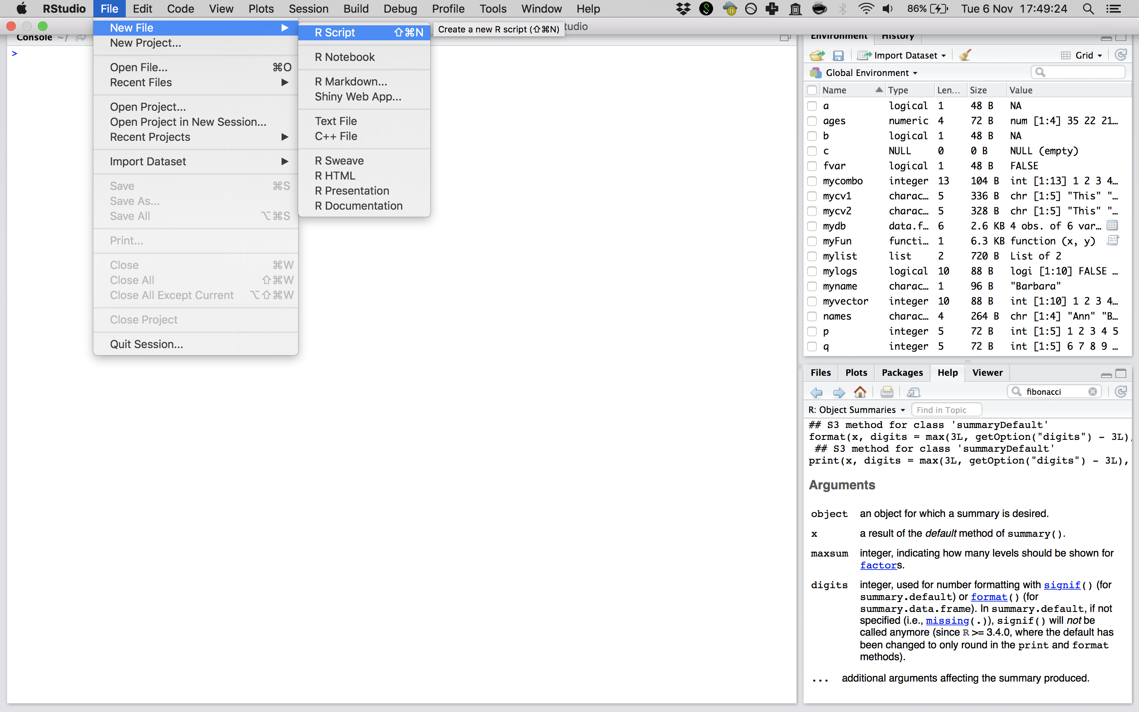
Ready to script?
RStudio > File > New File > R Script
Notes:
SHow how to write a script and execute lines right away!

Slide 57




Console vs script on our slides
> x <- 1
> x
[1] 1
# Assigning the value 1 to x
x <- 1
writing in the console
console output
# indicates comment
computer stops reading (but you should not!)

Slide 58
Programming: functions
Multiple instructions that form a cohesive unit
Should be able to be repeated on different inputs
add up all elements
in
count all elements
mean()
divide: sum/count
out

Slide 59
Live exercise: the assembly line of a function
in: a blank card
place a stamp
draw a wiggle
pretty_card()
cut a deco
out: pretty!

Slide 60
How would this look in R?
pretty_card <- function(x){
x <- place_stamp(x)
x <- draw_wiggle(x)
x <- cut_deco(x)
return(x)
}
> pretty_card( )
[1] 1

Slide 61
Programming: functions
myFun <- function(x,y){
z <- x*y
return(z)
}
> myFun(2,4)
[1] 8

Slide 62
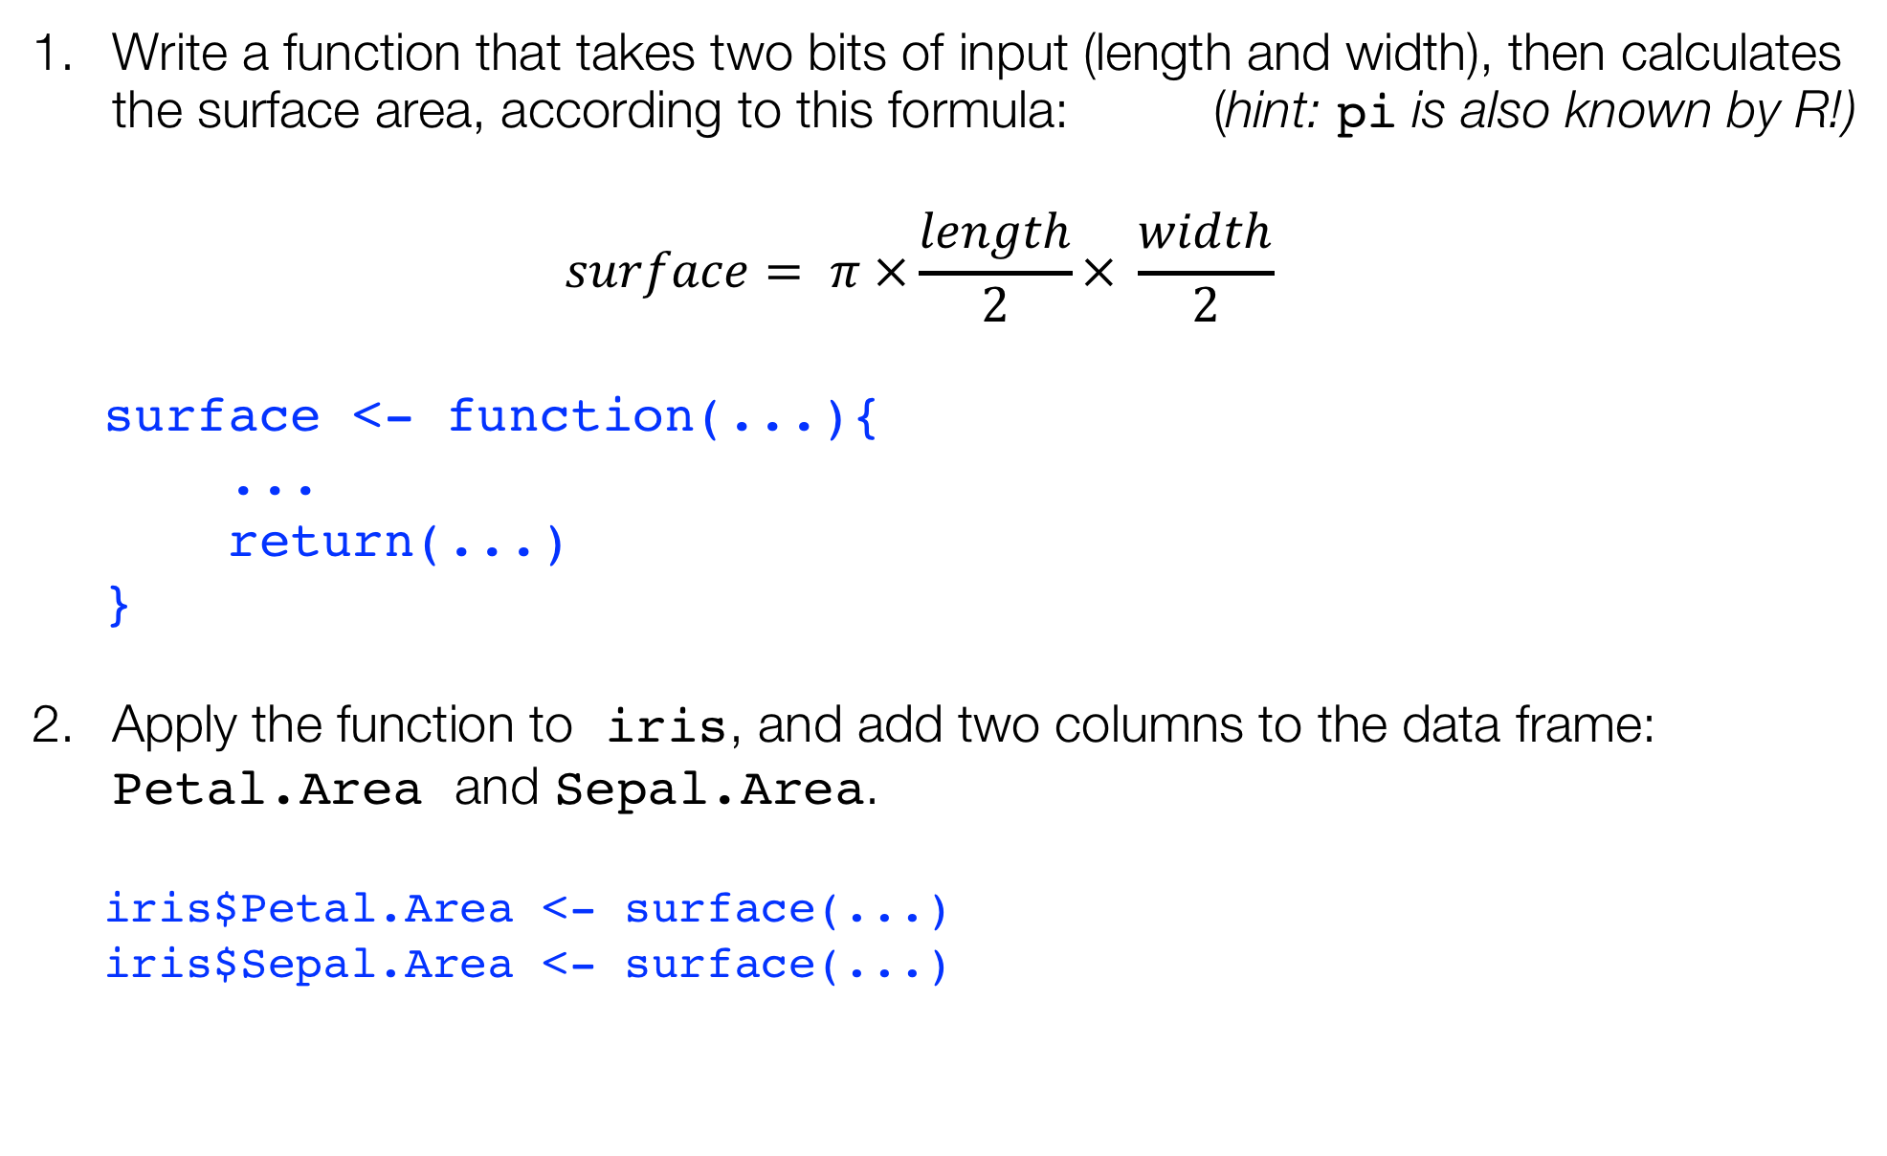
Exercise
Write a function that takes two bits of input (length and width), then calculates the surface area, according to this formula: (hint: pi is also known by R!)
$$surface= π ×\frac{length}{2}× \frac{width}{2}$$
surface <- function(...){
...
return(...)
}
Apply the function to iris, and add two columns to the data frame: Petal.Area and Sepal.Area.
iris$Petal.Area <- surface(...)
iris$Sepal.Area <- surface(...)

Slide 63
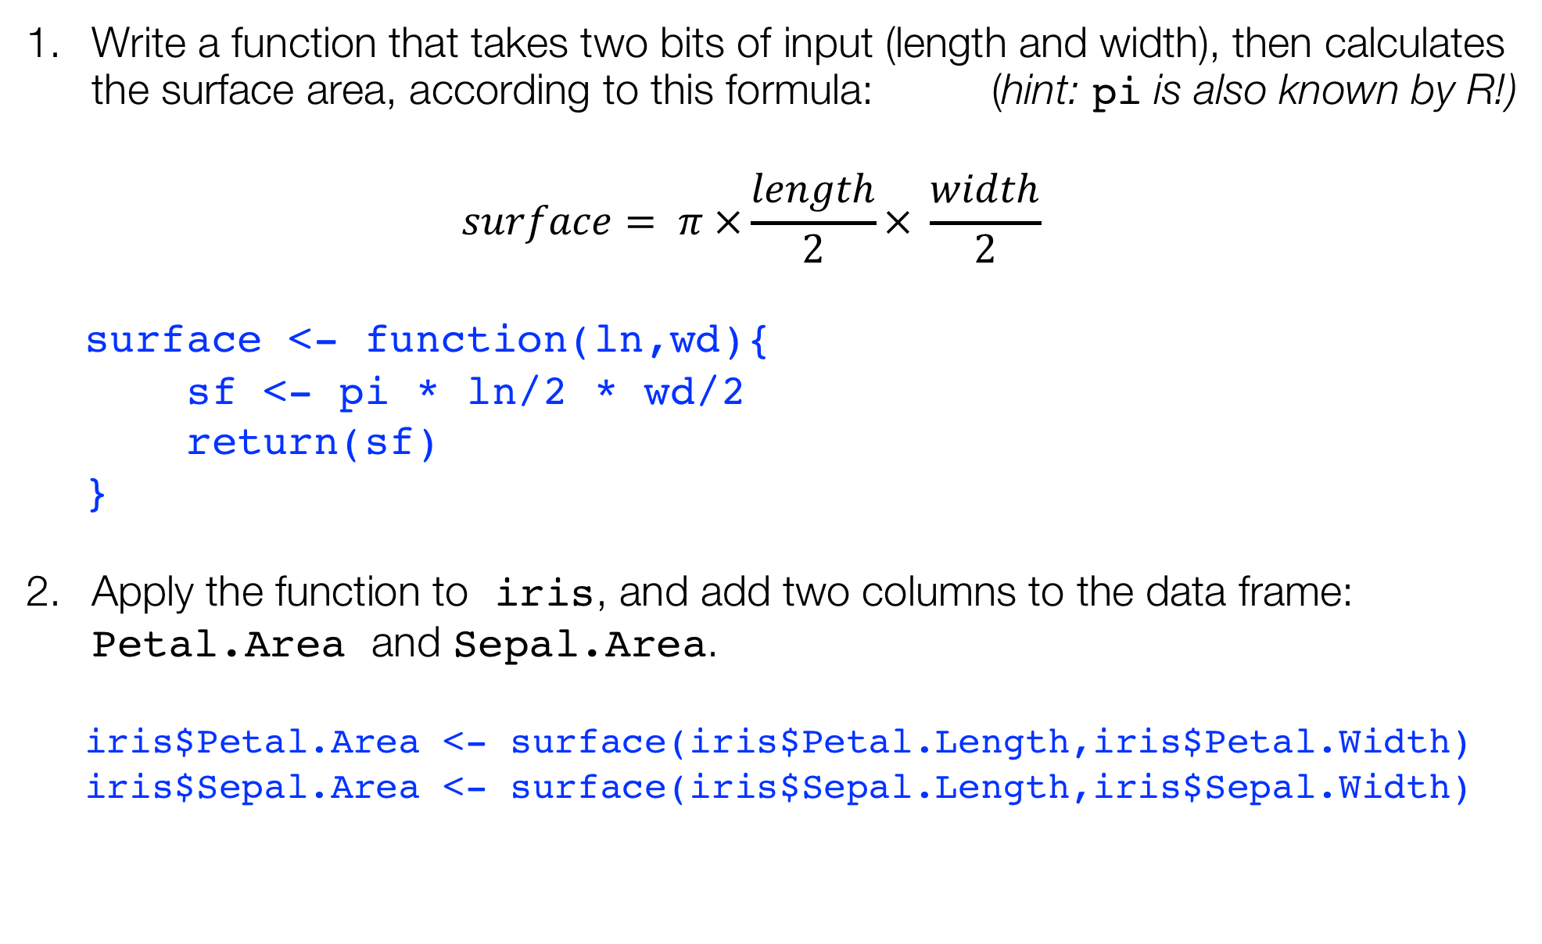
Exercise
Write a function that takes two bits of input (length and width), then calculates the surface area, according to this formula: (hint: pi is also known by R!)
$$surface= π ×\frac{length}{2}× \frac{width}{2}$$
surface <- function(ln,wd){
sf <- pi * ln/2 * wd/2
return(sf)
}
Apply the function to iris, and add two columns to the data frame: Petal.Area and Sepal.Area.
iris$Petal.Area <- surface(iris$Petal.Length,iris$Petal.Width)
iris$Sepal.Area <- surface(iris$Sepal.Length,iris$Sepal.Width)

Slide 64
Exercise
Write a function that takes a vector as input, and returns the mean of this vector (you can use the existing function mean() inside your function).
apply_calc <- function(...){
...
return(...)
}
Add further options to your function:
for example, the standard deviation (sd()), the minimum (min()), and the maximum (max()) of your input vector.
Put all of these calculations in a vector using the function c(), and return this result vector.
apply_calc <- function(...){
...
allres <- c(...)
return(...)
}

Slide 65
Exercise
Write a function that takes a vector as input, and returns the mean of this vector (you can use the existing function mean() inside your function).
apply_calc <- function(x){
m <- mean(x)
return(m)
}
Add further options to your function:
for example, the standard deviation (sd()), the minimum (min()), and the maximum (max()) of your input vector.
Put all of these calculations in a vector using the function c(), and return this result vector.
apply_calc <- function(x){
m <- mean(x)
s <- sd(x)
mi <- min(x)
ma <- max(x)
allres <- c(m,s,mi,ma)
return(allres)
}

Slide 66
Live exercise: the repeated action in a for-loop
for every card
in this collection…
cut a deco

Slide 67
How would this look in R?
for(i in ){
cut_deco(i)
}
[1] 1
[1] 2
[1] 3
[1] 4
[1] 5
[1] 6
for(i in 1:6){
print(i)
}
[1] 1
[1] 2
[1] 3
[1] 4
[1] 5
[1] 6

Slide 68
Exercise
Make a vector with all the column names in iris.
Hint: use the function colnames().
iriscols <- ...
Make a for-loop that iterates over all the column names in iris, and prints these column names.
for(...){
...
}
Elaborate on this for-loop: select the corresponding column in iris, and print the mean. Hint: yes, you should get a warning! Do you understand why?
for(...){
...
}

Slide 69
Exercise
Make a vector with all the column names in iris.
Hint: use the function colnames().
iriscols <- colnames(iris)
Make a for-loop that iterates over all the column names in iris, and prints these column names.
for(i in iriscols){
print(i)
}
Elaborate on this for-loop: select the corresponding column in iris, and print the mean. Hint: yes, you should get a warning! Do you understand why?
for(i in iriscols){
c <- iris[,i]
stat <- mean(c)
print(stat)
}

Slide 70
What’s wrong? And how do we fix it?
for(i in iriscols){
# select the appropriate column
c <- iris[,i]
# calculate the mean
stats <- mean(c)
# print the mean
print(stats)
}
[1] 5.843333
[1] 3.057333
[1] 3.758
[1] 1.199333
[1] NA
Warning message:
In mean.default(c) : argument is not numeric or logical: returning NA

Slide 71
Live exercise: the selectivity of an if-statement
for every card
in this collection…
is it yellow?
yes
cut a deco
no
stamp
PS: note how this is still a for-loop? That’s not a requirement!

Slide 72
How would this look in R?
for(i in ){
if(x == y){
cut_deco(i)
} else{
stamp(i)
}
}
[1] 1
[1] 2
[1] 3
[1] 4
[1] 5
[1] 6
for(i in 1:6){
if(i > 3){
print("Large!")
} else{
print("small...")
}
}
[1] "small..."
[1] "small..."
[1] "small..."
[1] "Large!"
[1] "Large!"
[1] "Large!"

Slide 73
Programming: if-statement
d <- 5
if(is.na(d)){
print("My data is missing!")
} else if(is.null(d)){
print("My data does not even exist...")
} else{
print("I have data!")
}
[1] "I have data!"

Slide 74
Exercise: choose one!
Copy-paste the for-loop you made in the previous exercise. Inside this for-loop, add an if-statement, so that mean() is only performed on numeric vectors. Hint: check the function is.numeric().
for(i in iriscols){
c <- iris[,i]
...
}
Are you feeling comfortable with the material?
Open the file ‘programming_exercise.R’
Read through the code, see if you understand it (it is mostly the previous two exercises, but with some small tweaks!)
Scroll down to line 32 for the exercise.
Read the bonus material — you can check your work with the code there.

Slide 75
Exercise: choose one!
Copy-paste the for-loop you made in the previous exercise. Inside this for-loop, add an if-statement, so that mean() is only performed on numeric vectors. Hint: check the function is.numeric().
for(i in iriscols){
c <- iris[,i]
if(is.numeric(c)){
stat <- mean(c)
print(stat)
}
}
Are you feeling comfortable with the material?
Open the file ‘programming_exercise.R’
Read through the code, see if you understand it (it is mostly the previous two exercises, but with some small tweaks!)
Scroll down to line 32 for the exercise.
Read the bonus material — you can check your work with the code there.

Slide 76
Data science workflow: scripting is crucial
Scripting combines commands to a comprehensive set of instructions.
A script is code that can be saved, reused, shared, published!
In short: a crucial step towards reproducible data analysis.
a single script for a single purpose!

Slide 77
Starting the script: write a header
## Date: 7 November 2018
## Author: Barbara Vreede
## This script was written as part of the R course
## "Introduction to R & Data", at Utrecht University
Notes:
Think about: dependencies, version, purpose…

Slide 78
Load packages and dependencies
## Date: 7 November 2018
## Author: Barbara Vreede
## This script was written as part of the R course
## "Introduction to R & Data", at Utrecht University
# Load required packages
library(dplyr)
library(tidyr)
library(ggplot2)

Slide 79
Custom functions
## Date: 7 November 2018
## Author: Barbara Vreede
## This script was written as part of the R course
## "Introduction to R & Data", at Utrecht University
# Load required packages
library(dplyr)
library(tidyr)
library(ggplot2)
# Functions
myFun <- function(var){
var <- var*2*pi
return(var)
}

Slide 80
Starting your script: header, packages, functions
## Date: 7 November 2018
## Author: Barbara Vreede
## This script was written as part of the R course
## "Introduction to R & Data", at Utrecht University
# Load required packages
library(dplyr)
library(tidyr)
library(ggplot2)
# Functions
myFun <- function(var){
var <- var*2*pi
return(var)
}

Slide 81
To check before lunch: please load tidyverse
> library(tidyverse)
── Attaching packages ─────────────────────── tidyverse 1.2.1 ──
✔ ggplot2 3.1.0 ✔ purrr 0.3.0
✔ tibble 2.0.1 ✔ dplyr 0.7.8
✔ tidyr 0.8.2 ✔ stringr 1.4.0
✔ readr 1.3.1 ✔ forcats 0.3.0
── Conflicts ────────────────────────── tidyverse_conflicts() ──
✖ dplyr::filter() masks stats::filter()
✖ dplyr::lag() masks stats::lag()

Slide 82
Enjoy your lunch!

Slide 83
Introduction to R & data
Part II: Modern R with tidyverse

Slide 84
Outline part II
Introduction to tidyverse, rmarkdown, and tibble.
Load and save data with readr
[break]
Data visualisation with ggplot
[break]
Data transformation with tidyr and dplyr

Slide 85

Tidyverse
Modern R for data science
Notes:
Recently developed
Fast adoption by community
Integration with RStudio
Dev by Wickham
- Collection of packages
Everyone can make extensions to the tidyverse
dplyr and ggplot2 are the most well known packages
Easy to switch between base R and tidyverse

Slide 86
"The tidyverse is an opinionated collection of R packages designed for data science. All packages share an underlying design philosophy, grammar, and data structures."
– tidyverse.org (2018)
Notes:
Discuss
Base R is confusing/old, non-intuitive -> tidyverse introduces intuitive functions
Different developers and historical inconsistencies -> tidyverse has a shared grammar
"R is an old language, and some things that were useful 10 or 20 years ago now get in your way. It’s difficult to change base R without breaking existing code, so most innovation occurs in packages."

Slide 87

Data science workflow
Tidy data ensures that further processing can be done efficiently, and reproducibly.
Tidy data is easy to manipulate, model, and visualize.

Slide 88



Tidy data
multiple observations per row
values in column names
Each variable is a column and contains values
Each observation is a row
Each type of observational unit forms a table
Patient | Temp | Med_A | Temp_A | Med_B | Temp_B
122030 | 37.0 | 300 | 37.1 | NA | NA
122021 | 38.2 | 200 | 38.1 | 85 | 36.5
124500 | 38.1 | 300 | 38.0 | NA | NA
126098 | 39.1 | NA | NA | 100 | 36.8

Slide 89




Tidy data
ID no longer unique per row (but can still be used to collect all info on single patient)
Patient | Temp | Treatment | Dose
122030 | 37.0 | None | NA
122030 | 37.1 | A | 300
122021 | 38.2 | None | NA
122021 | 38.1 | A | 200
122021 | 36.5 | B | 85
124500 | 38.1 | None | NA
124500 | 38.0 | A | 300
126098 | 39.1 | None | NA
126098 | 36.8 | B | 100
Time series (order) lost (so make sure this is explicit)

Slide 90

Learn tidyverse
R for Data Science (book); freely available on r4ds.had.co.nz/

Slide 91
Learn tidyverse
R for Data Science (book); freely available on r4ds.had.co.nz/
ggplot2 (book)

Slide 92
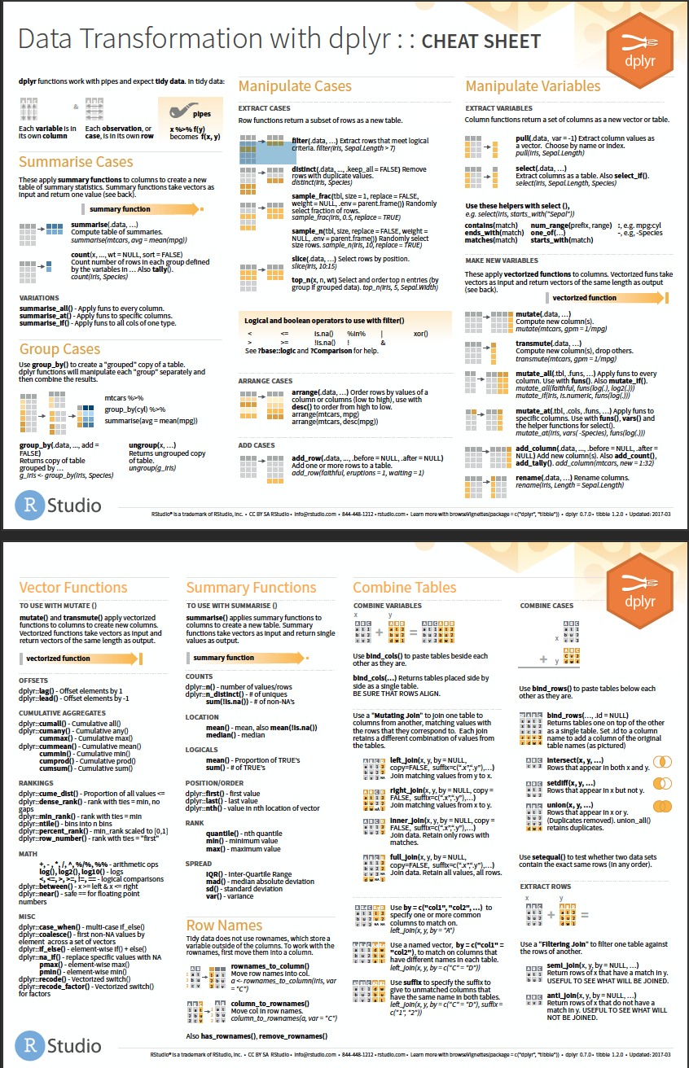
Learn tidyverse
R for Data Science (book); freely available on r4ds.had.co.nz/
ggplot2 (book)
cheatsheets www.rstudio.com/resources/cheatsheets/

Slide 93
Your afternoon roadmap
A short explanation on screen (~15 minutes)
Exercises in a document on your computer (~45 minutes)
2-3 basic exercises
optional exercises, for further practice
reading exercises, for some extra insight into Tidyverse
We will work with a new data set
The exercises are presented in Rmarkdown format. We’ll explain this later!

Slide 94

From code to document
Turn your analyses into high quality documents with Rmarkdown
Combine code with narrative (R with markdown)
Turn your analyses into high quality documents, reports, presentations and dashboards.
… or your note book.

Slide 95
Console, Scripts and Rmarkdown
Console | Code execution | -
Script | Code | Extension: .R (example_script.R)
Rmarkdown | Code + Narrative | Extension: .Rmd (example_report.Rmd)
Notes:
Move and duplicate this slide.
Remove Rmarkdown at this stage. Show it later on

Slide 96
Markdown
# title
Some text about your project
## Section
More text about your project
```{r}
max(iris$Petal.Length)
min(iris$Petal.Length)
```

Slide 97
Rmarkdown: demo

Slide 98
Exercise: open the exercise Rmarkdown
1. RStudio > File > Open Project > introduction-to-R-and-data-github.Rproj
2. From the ‘files’ menu (bottom right), select modernR_exercises.Rmd
3. Update the header information with your name!

Slide 99
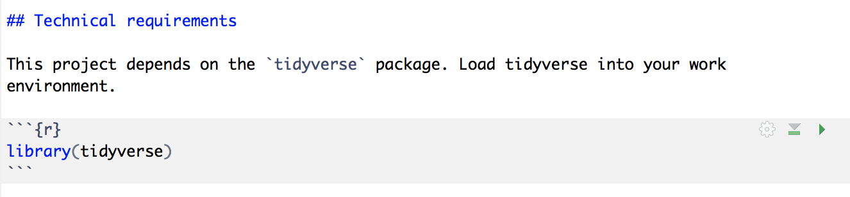

Run the first code chunk!
> library(tidyverse)
── Attaching packages ─────────────────────── tidyverse 1.2.1 ──
✔ ggplot2 3.1.0 ✔ purrr 0.3.0
✔ tibble 2.0.1 ✔ dplyr 0.7.8
✔ tidyr 0.8.2 ✔ stringr 1.4.0
✔ readr 1.3.1 ✔ forcats 0.3.0
── Conflicts ────────────────────────── tidyverse_conflicts() ──
✖ dplyr::filter() masks stats::filter()
✖ dplyr::lag() masks stats::lag()

Slide 100
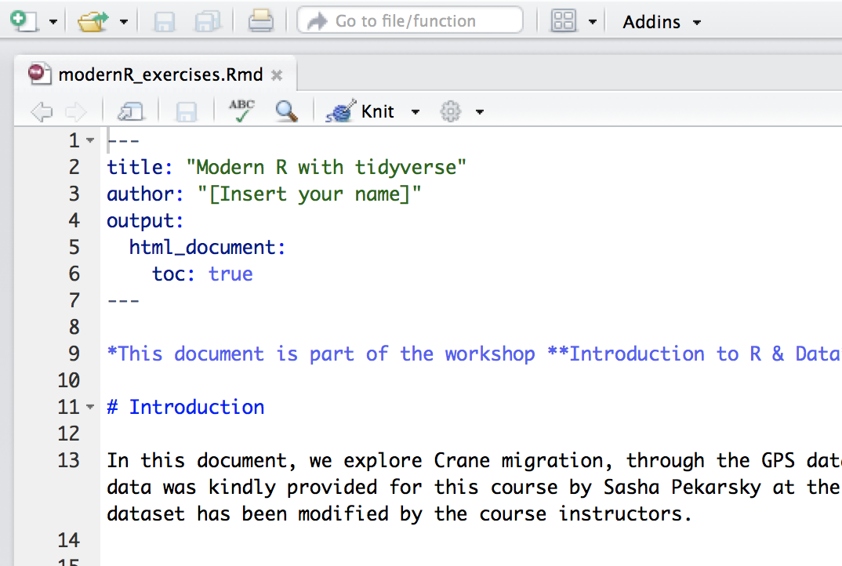

All done? Time to knit!

Slide 101

package: Tibble
"Tibbles are data frames, but they tweak some older behaviours to make life a little easier.”
- Hadley Wickham

Slide 102
Tibbles
> tibble(a = 1:26, b = letters)
# A tibble: 26 x 2
a b
<int> <chr>
1 1 a
2 2 b
3 3 c
4 4 d
5 5 e
6 6 f
7 7 g
8 8 h
9 9 i
10 10 j
# ... with 16 more rows

Slide 103
Tibbles: from data.frame to tibble
> as_tibble(iris)
# A tibble: 150 x 5
Sepal.Length Sepal.Width Petal.Length Petal.Width Species
<dbl> <dbl> <dbl> <dbl> <fct>
1 5.10 3.50 1.40 0.200 setosa
2 4.90 3.00 1.40 0.200 setosa
3 4.70 3.20 1.30 0.200 setosa
4 4.60 3.10 1.50 0.200 setosa
5 5.00 3.60 1.40 0.200 setosa
6 5.40 3.90 1.70 0.400 setosa
7 4.60 3.40 1.40 0.300 setosa
8 5.00 3.40 1.50 0.200 setosa
9 4.40 2.90 1.40 0.200 setosa
10 4.90 3.10 1.50 0.100 setosa
# ... with 140 more rows

Slide 104
Tibbles: from tibble to data.frame
> iris_tibble <- as_tibble(iris)
> as.data.frame(iris_tibble)
Sepal.Length Sepal.Width Petal.Length Petal.Width Species
1 5.1 3.5 1.4 0.2 setosa
2 4.9 3.0 1.4 0.2 setosa
3 4.7 3.2 1.3 0.2 setosa
4 4.6 3.1 1.5 0.2 setosa
5 5.0 3.6 1.4 0.2 setosa
6 5.4 3.9 1.7 0.4 setosa
7 4.6 3.4 1.4 0.3 setosa
8 5.0 3.4 1.5 0.2 setosa
9 4.4 2.9 1.4 0.2 setosa
10 4.9 3.1 1.5 0.1 setosa
11 5.4 3.7 1.5 0.2 setosa
12 4.8 3.4 1.6 0.2 setosa
13 4.8 3.0 1.4 0.1 setosa
14 4.3 3.0 1.1 0.1 setosa
15 5.8 4.0 1.2 0.2 setosa
16 5.7 4.4 1.5 0.4 setosa
17 5.4 3.9 1.3 0.4 setosa
18 5.1 3.5 1.4 0.3 setosa
19 5.7 3.8 1.7 0.3 setosa
20 5.1 3.8 1.5 0.3 setosa
21 5.4 3.4 1.7 0.2 setosa
22 5.1 3.7 1.5 0.4 setosa
23 4.6 3.6 1.0 0.2 setosa
24 5.1 3.3 1.7 0.5 setosa

Slide 105

Load and save data
The basics of readr

Slide 106
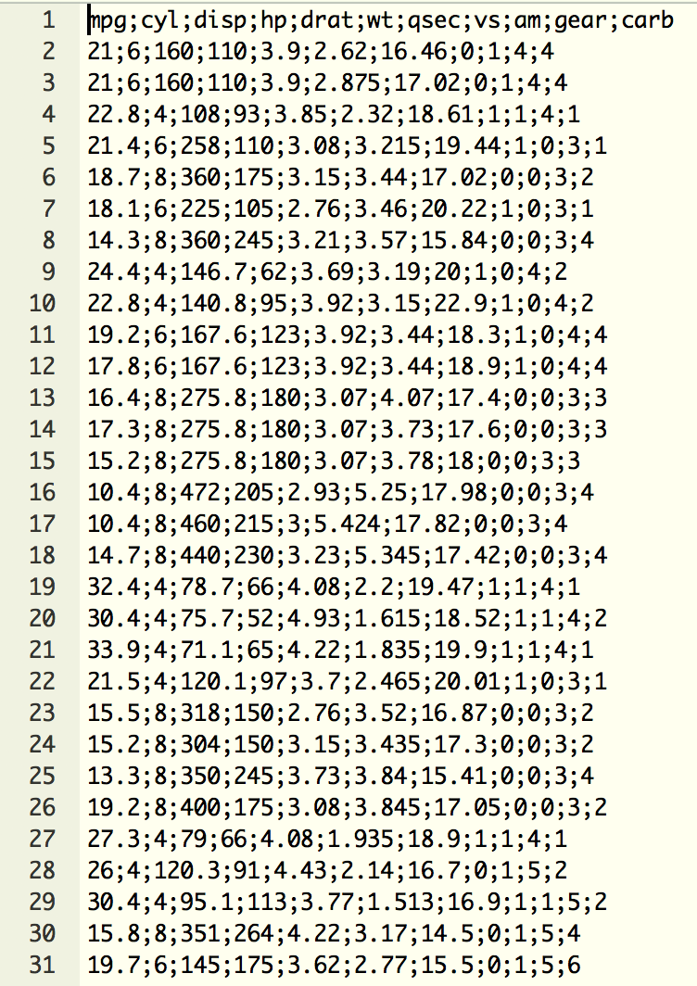
Flat data files
Most common format: Comma-separated values (CSV)
Delimiter-separated values (also stored as CSV)
Common delimiters:
comma ,
semicolon ;
tab \t

Slide 107
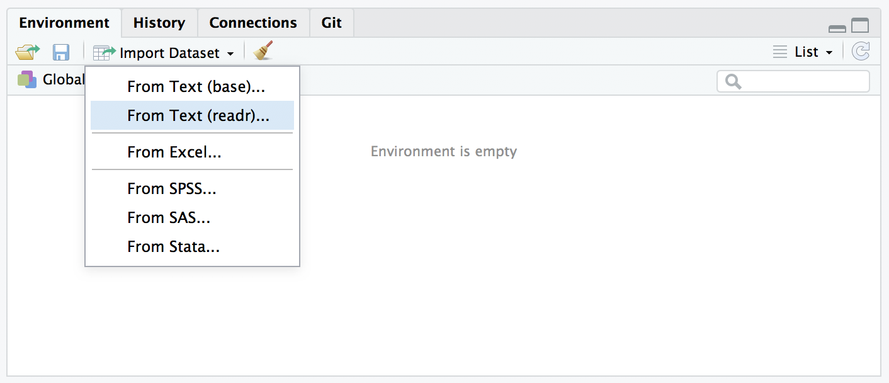

Load data by using buttons

Slide 108
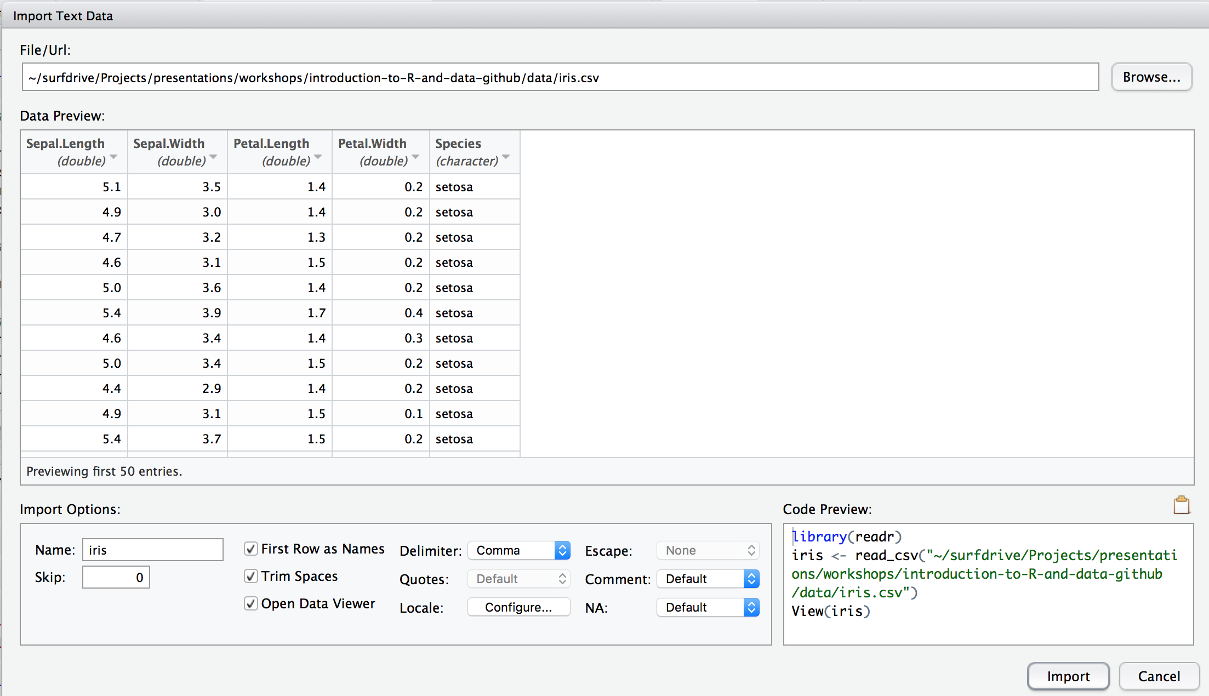


Load data by using buttons

Slide 109

Read flat files
> library(readr)
> data_iris <- read_delim("data/iris.csv", delim=',')

Slide 110
Read flat files
> library(readr)
> data_iris <- read_delim("data/iris.csv", delim=',')
Parsed with column specification:
cols(
Sepal.Length = col_double(),
Sepal.Width = col_double(),
Petal.Length = col_double(),
Petal.Width = col_double(),
Species = col_character()
)

Slide 111
Read flat files
> library(readr)
> data_iris <- read_csv("data/iris.csv")
Parsed with column specification:
cols(
Sepal.Length = col_double(),
Sepal.Width = col_double(),
Petal.Length = col_double(),
Petal.Width = col_double(),
Species = col_character()
)

Slide 112
Exercise dataset
GPS data from 39 tagged individual cranes during fall migration of 2017
Courtesy of Sasha Pekarsky at the Hebrew University of Jerusalem, Israel
In the ‘data’ folder of your course materials.
Notes:
Yes Jonathan, cranes are birds.

Slide 113
Exercises
Please do basic exercises 1-I and 1-II.
Time left? Opt for a reading exercise or optional exercise!

Slide 114

Data visualisation
Create eye candy with ggplot2

Slide 115
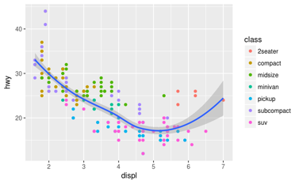
Examples of plots with R (and ggplot2)

Slide 116
Data visualisation with ggplot2
ggplot2 is an extremely popular data visualisation package for R
Simple syntax, easy to learn, nice plots
Developed and maintained by Hadley Wickham
Based on the book: The Grammar of Graphics (Wilkinson, 2005)

Slide 117
The grammar of graphics
Data | The variables in a tibble or data.frame
Aesthetics | x- and y-axis, colour, size, alpha, shape
Geometries | point, line, bar, histogram
Source: https://www.youtube.com/watch?v=uiTc55clwuA

Slide 118
Quick plotting

Slide 119
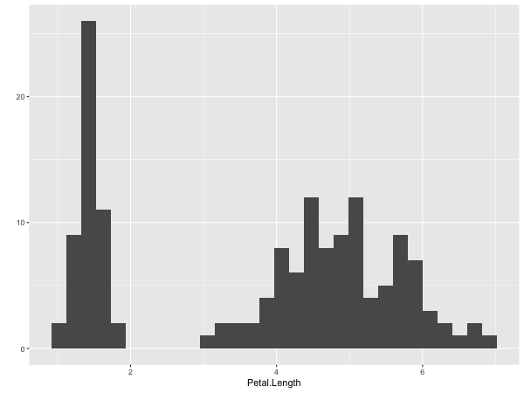
Quick plots
> qplot(Petal.Length, data = iris)

Slide 120
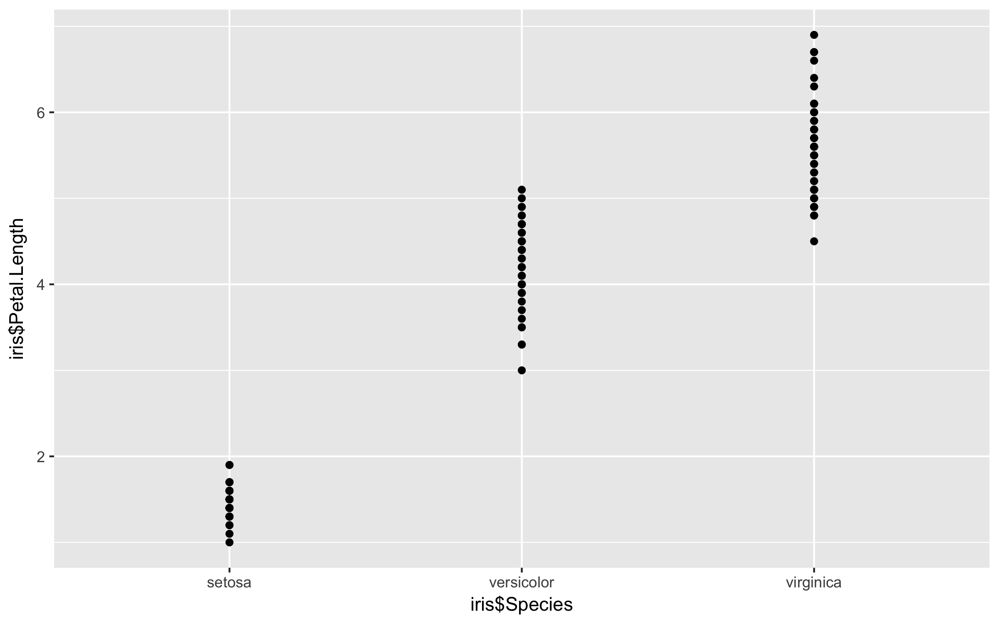
Quick plots
> qplot(Petal.Length, data = iris)
> qplot(Species, Petal.Length, data = iris)

Slide 121
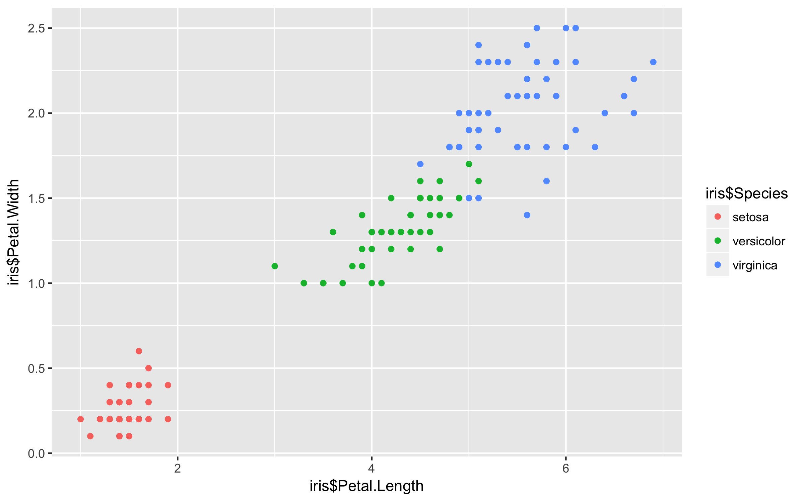
Quick plots
> qplot(Petal.Length, data = iris)
> qplot(Species, Petal.Length, data = iris)
> qplot(Petal.Length, Petal.Width, data = iris, colour=Species)

Slide 122
ggplot (grammar of graphics)

Slide 123

ggplot: Data, aesthetics, geometrics
> ggplot(iris)

Slide 124
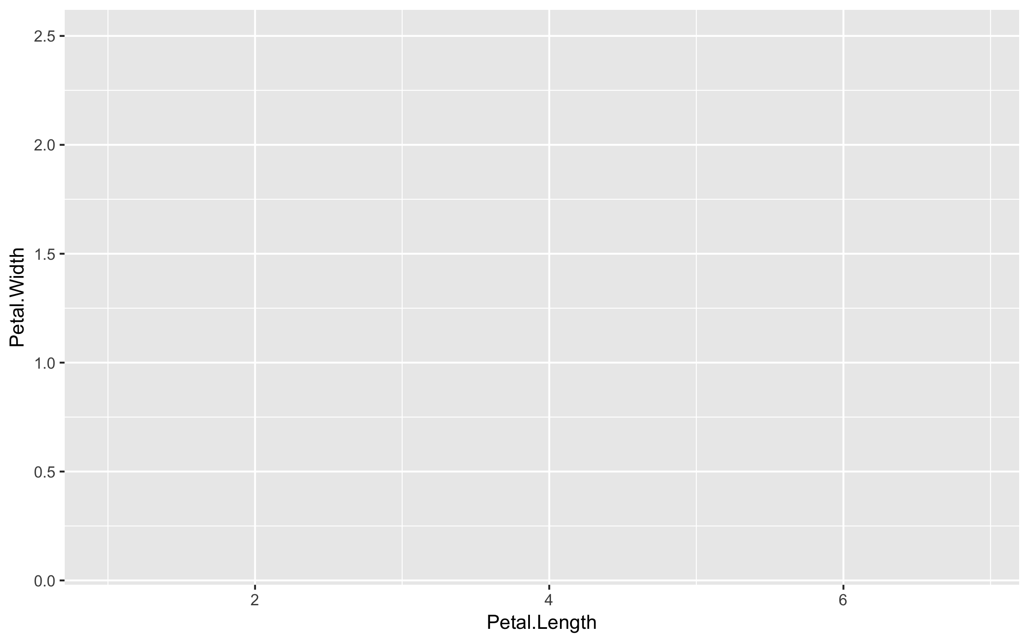
ggplot: Data, aesthetics, geometrics
> ggplot(iris)
> ggplot(iris, aes(x = Petal.Length, y = Petal.Width, colour=Species))

Slide 125
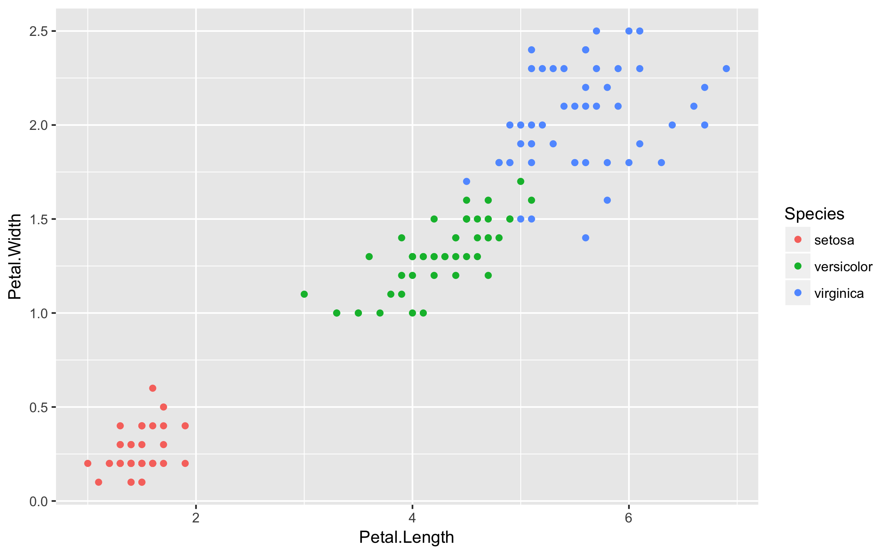
ggplot: Data, aesthetics, geometrics
> ggplot(iris)
> ggplot(iris, aes(x = Petal.Length, y = Petal.Width, colour=Species))
> ggplot(iris, aes(x = Petal.Length, y = Petal.Width, colour=Species)) +
geom_point()

Slide 126
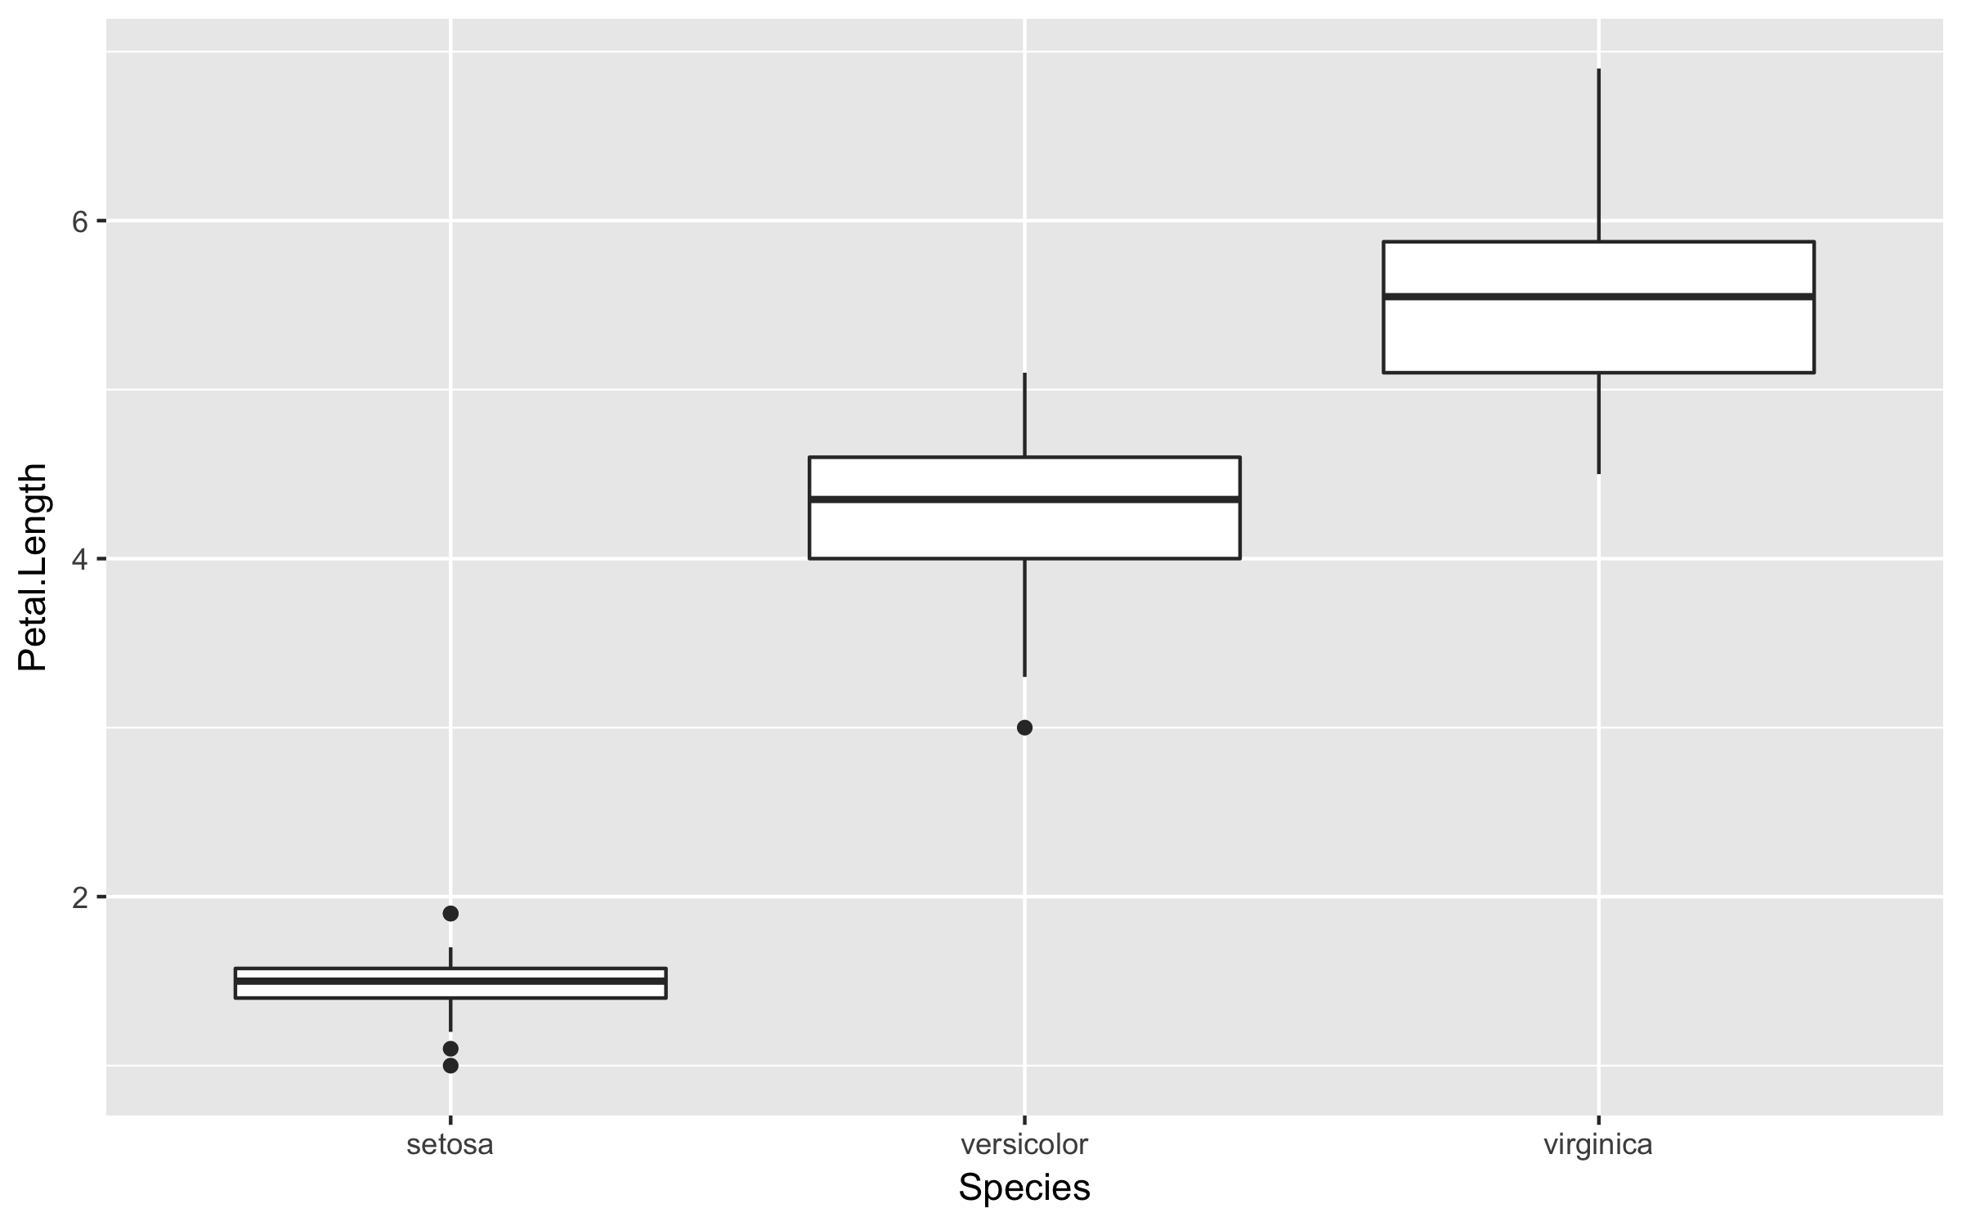
ggplot: Multiple geometric layers
> ggplot(iris, aes(x = Species, y = Petal.Length)) +
geom_boxplot()

Slide 127
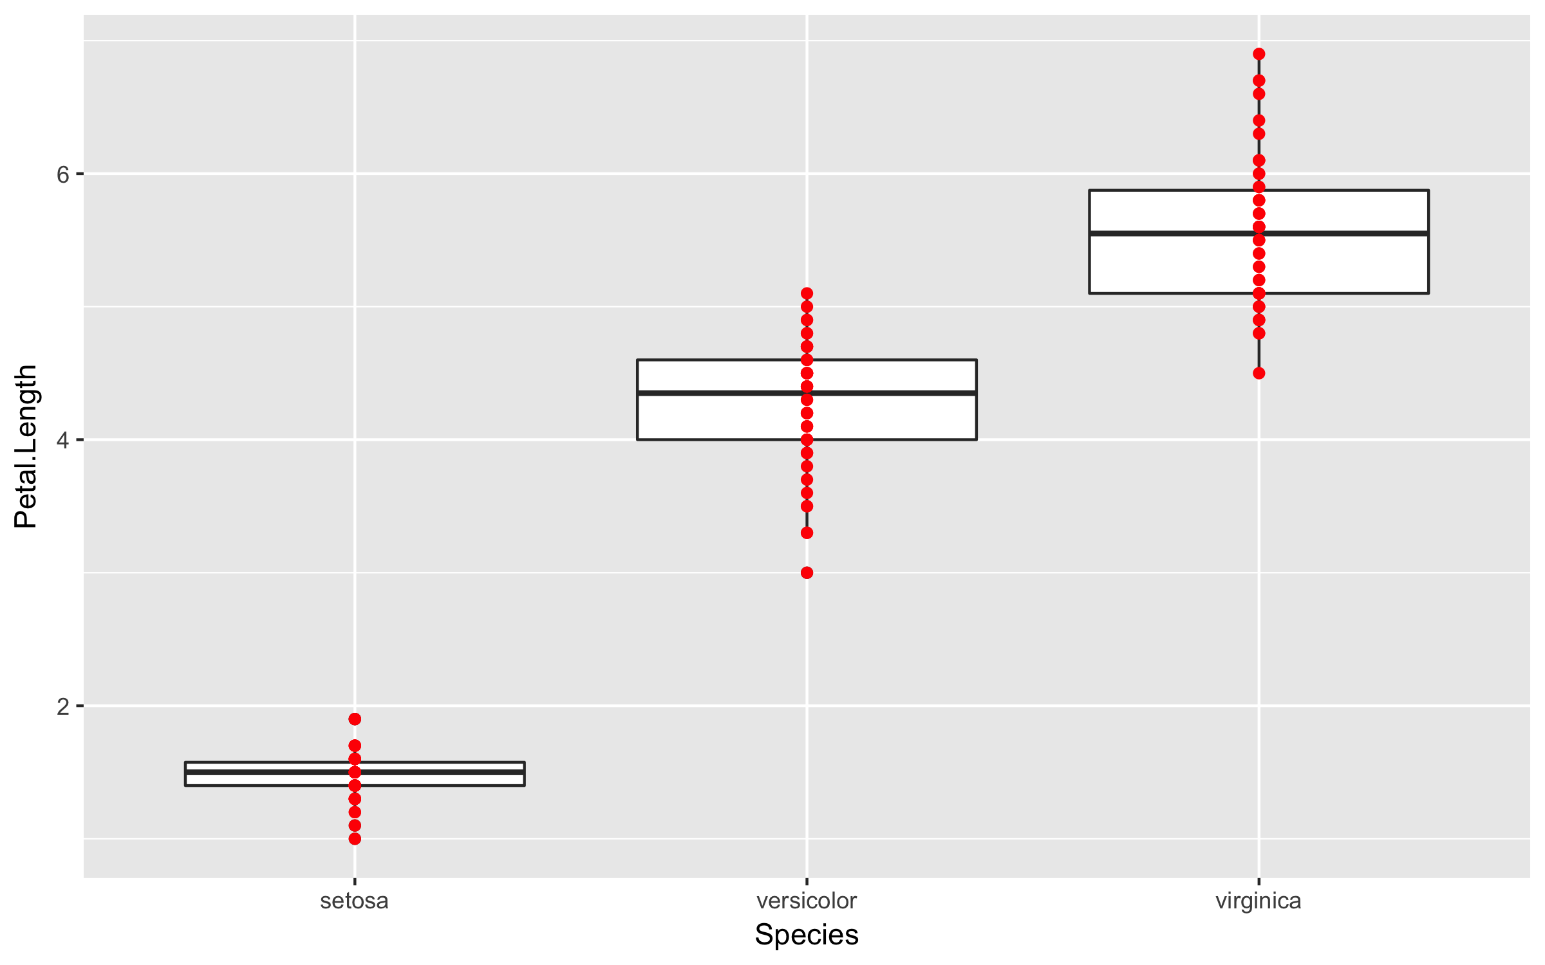
ggplot: Multiple geometric layers
> ggplot(iris, aes(x = Species, y = Petal.Length)) +
geom_boxplot() +
geom_point(colour='red')

Slide 128
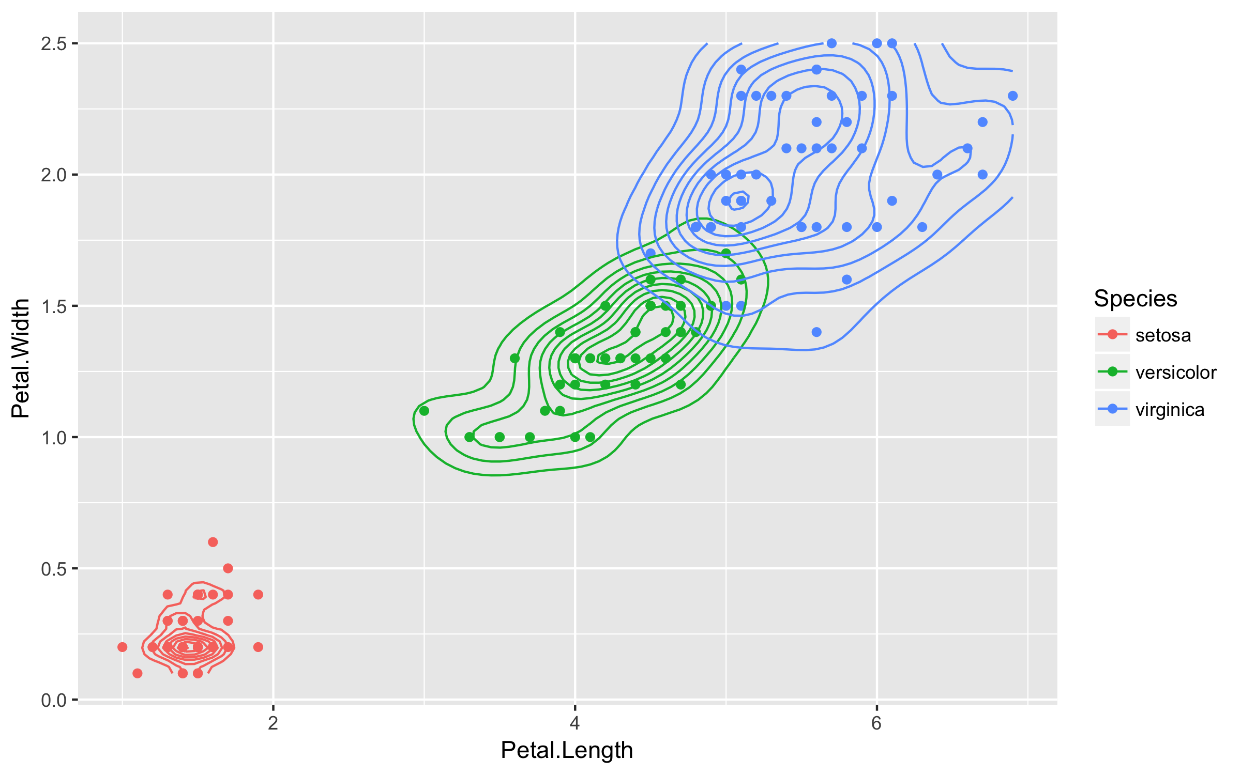
ggplot: Statistical layers
> ggplot(iris, aes(x = Petal.Length, y = Petal.Width, colour=Species)) +
geom_point() +
stat_density_2d()

Slide 129
Exercises
Please do basic exercises 2-I and 2-II.
Time left? Opt for a reading exercise or optional exercise!

Slide 130


Data transformation
Explore the power of dplyr and tidyr

Slide 131
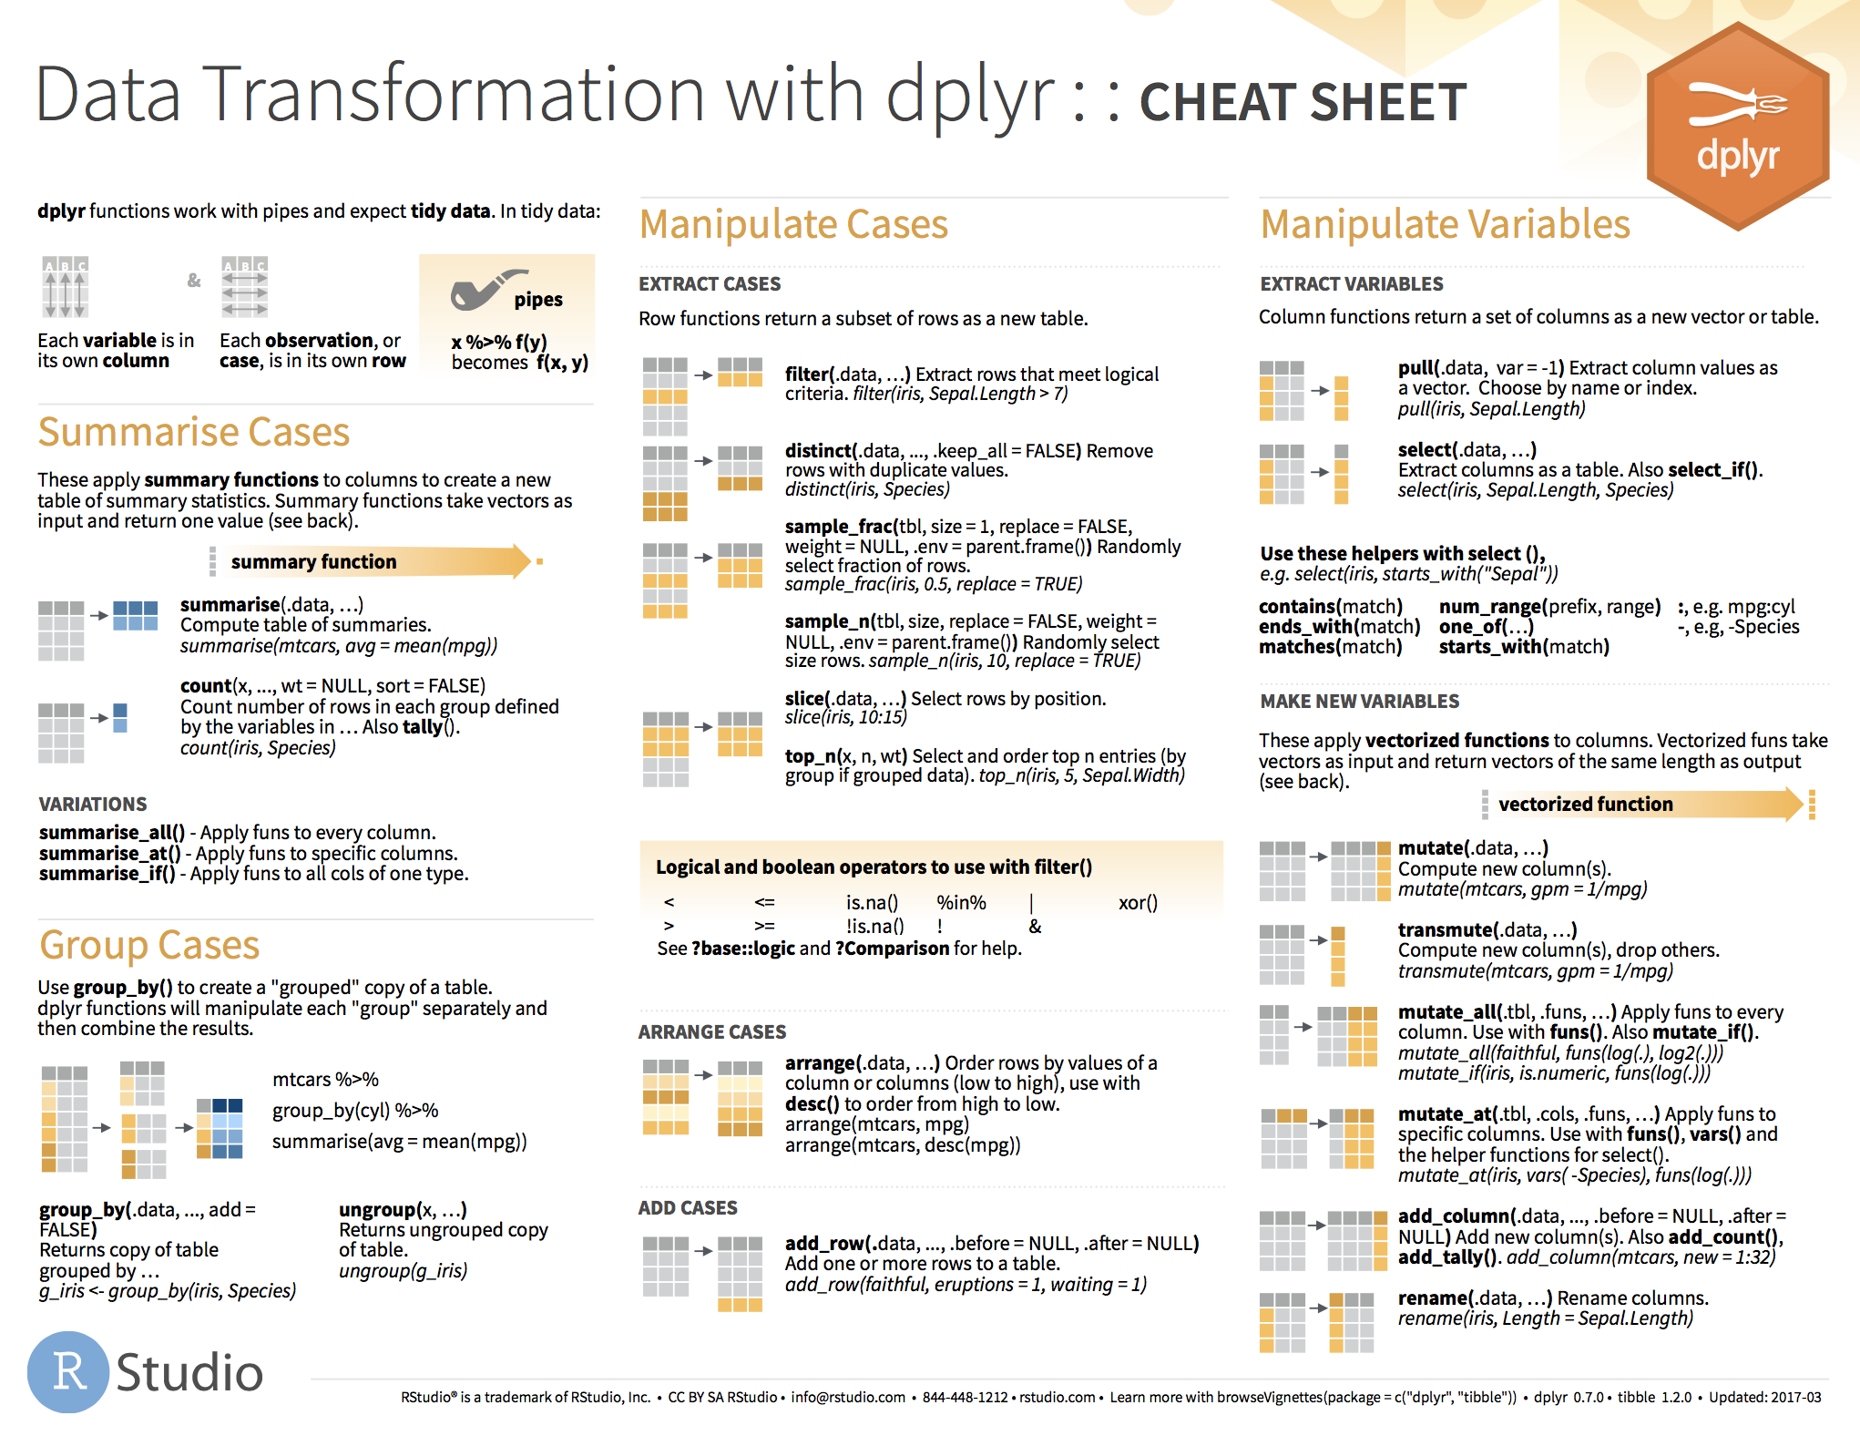

Slide 132
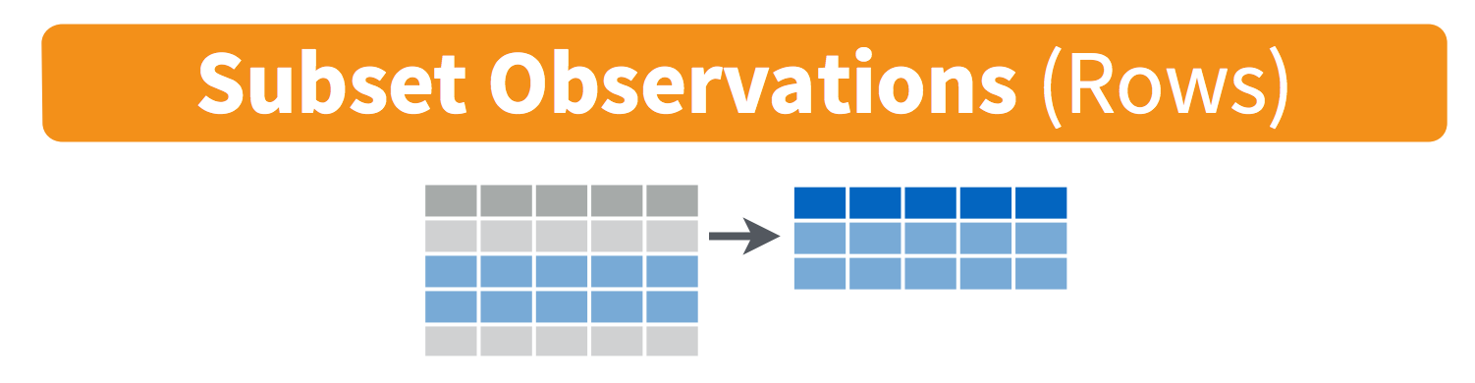
filter()
Notes:
https://jules32.github.io/2016-07-12-Oxford/dplyr_tidyr/

Slide 133
Function: filter()
> filter(iris, Species=="virginica")

Slide 134
Function: filter()
> filter(iris, Species=="virginica")
# A tibble: 50 x 5
Sepal.Length Sepal.Width Petal.Length Petal.Width Species
<dbl> <dbl> <dbl> <dbl> <fct>
1 6.30 3.30 6.00 2.50 virginica
2 5.80 2.70 5.10 1.90 virginica
3 7.10 3.00 5.90 2.10 virginica
4 6.30 2.90 5.60 1.80 virginica
5 6.50 3.00 5.80 2.20 virginica
6 7.60 3.00 6.60 2.10 virginica
7 4.90 2.50 4.50 1.70 virginica
8 7.30 2.90 6.30 1.80 virginica
9 6.70 2.50 5.80 1.80 virginica
10 7.20 3.60 6.10 2.50 virginica
# ... with 40 more rows

Slide 135
Function: filter()
> filter(iris, Species=="virginica", Sepal.Length>= 7.5)

Slide 136
Function: filter()
> filter(iris, Species=="virginica", Sepal.Length>= 7.5)
# A tibble: 6 x 5
Sepal.Length Sepal.Width Petal.Length Petal.Width Species
<dbl> <dbl> <dbl> <dbl> <fct>
1 7.60 3.00 6.60 2.10 virginica
2 7.70 3.80 6.70 2.20 virginica
3 7.70 2.60 6.90 2.30 virginica
4 7.70 2.80 6.70 2.00 virginica
5 7.90 3.80 6.40 2.00 virginica
6 7.70 3.00 6.10 2.30 virginica

Slide 137
Function: filter()
> filter(iris, Species=="virginica", Sepal.Length>= 7.5)
# A tibble: 6 x 5
Sepal.Length Sepal.Width Petal.Length Petal.Width Species
<dbl> <dbl> <dbl> <dbl> <fct>
1 7.60 3.00 6.60 2.10 virginica
2 7.70 3.80 6.70 2.20 virginica
3 7.70 2.60 6.90 2.30 virginica
4 7.70 2.80 6.70 2.00 virginica
5 7.90 3.80 6.40 2.00 virginica
6 7.70 3.00 6.10 2.30 virginica
Same as:
> filter(iris, Species=="virginica" & Sepal.Length>= 7.5)

Slide 138
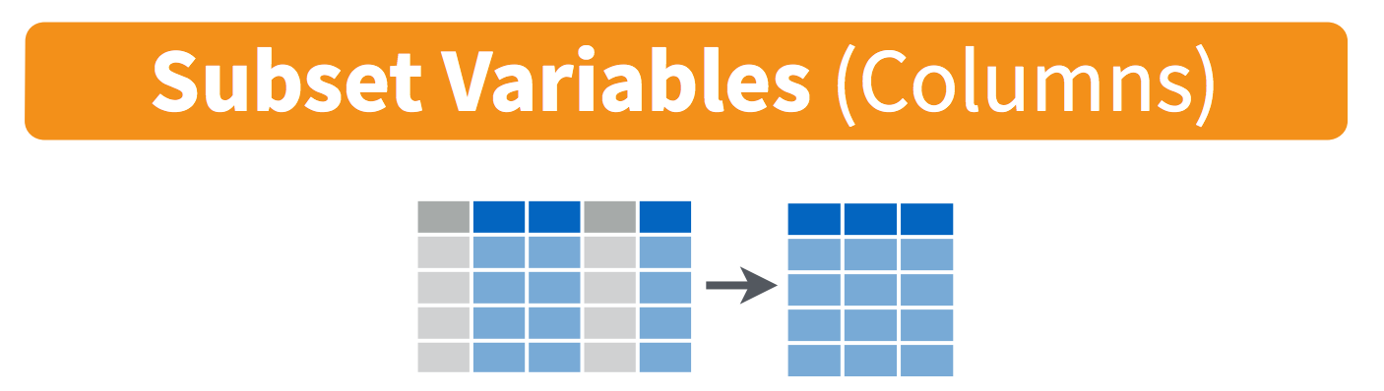
select()
Notes:
https://jules32.github.io/2016-07-12-Oxford/dplyr_tidyr/

Slide 139
Function: select()
> select(iris, Sepal.Length, Sepal.Width, Species)

Slide 140
Function: select()
> select(iris, Sepal.Length, Sepal.Width, Species)
# A tibble: 150 x 3
Sepal.Length Sepal.Width Species
<dbl> <dbl> <fct>
1 5.10 3.50 setosa
2 4.90 3.00 setosa
3 4.70 3.20 setosa
4 4.60 3.10 setosa
5 5.00 3.60 setosa
6 5.40 3.90 setosa
7 4.60 3.40 setosa
8 5.00 3.40 setosa
9 4.40 2.90 setosa
10 4.90 3.10 setosa
# ... with 140 more rows

Slide 141

Function: select()
> select(iris, Sepal.Length, Sepal.Width, Species)
> select(iris, starts_with("Sepal"), Species)

Slide 142
Function: select()
> select(iris, Sepal.Length, Sepal.Width, Species)
> select(iris, starts_with("Sepal"), Species)
# A tibble: 150 x 3
Sepal.Length Sepal.Width Species
<dbl> <dbl> <fct>
1 5.10 3.50 setosa
2 4.90 3.00 setosa
3 4.70 3.20 setosa
4 4.60 3.10 setosa
5 5.00 3.60 setosa
6 5.40 3.90 setosa
7 4.60 3.40 setosa
8 5.00 3.40 setosa
9 4.40 2.90 setosa
10 4.90 3.10 setosa
# ... with 140 more rows

Slide 143
Function: select()
> select(iris, Sepal.Length, Sepal.Width, Species)
> select(iris, starts_with("Sepal"), Species)
> select(iris, -starts_with("Petal"))

Slide 144
Function: select()
> select(iris, Sepal.Length, Sepal.Width, Species)
> select(iris, starts_with("Sepal"), Species)
> select(iris, -starts_with("Petal"))
# A tibble: 150 x 3
Sepal.Length Sepal.Width Species
<dbl> <dbl> <fct>
1 5.10 3.50 setosa
2 4.90 3.00 setosa
3 4.70 3.20 setosa
4 4.60 3.10 setosa
5 5.00 3.60 setosa
6 5.40 3.90 setosa
7 4.60 3.40 setosa
8 5.00 3.40 setosa
9 4.40 2.90 setosa
10 4.90 3.10 setosa
# ... with 140 more rows

Slide 145
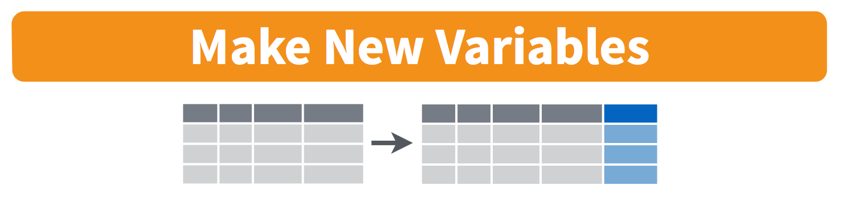
mutate()
Notes:
https://jules32.github.io/2016-07-12-Oxford/dplyr_tidyr/

Slide 146
Function: mutate()
> mutate(iris,
petal_area = pi * Petal.Length/2 * Petal.Width/2)

Slide 147
Function: mutate()
> mutate(iris,
petal_area = pi * Petal.Length/2 * Petal.Width/2)
# A tibble: 150 x 6
Sepal.Length Sepal.Width Petal.Length Petal.Width Species petal_area
<dbl> <dbl> <dbl> <dbl> <fct> <dbl>
1 5.1 3.5 1.4 0.2 setosa 0.220
2 4.9 3 1.4 0.2 setosa 0.220
3 4.7 3.2 1.3 0.2 setosa 0.204
4 4.6 3.1 1.5 0.2 setosa 0.236
5 5 3.6 1.4 0.2 setosa 0.220
6 5.4 3.9 1.7 0.4 setosa 0.534
7 4.6 3.4 1.4 0.3 setosa 0.330
8 5 3.4 1.5 0.2 setosa 0.236
9 4.4 2.9 1.4 0.2 setosa 0.220
10 4.9 3.1 1.5 0.1 setosa 0.118
# ... with 140 more rows

Slide 148
Function: mutate()
> mutate(iris,
# compute the area of a single petal
petal_area = pi * Petal.Length/2 * Petal.Width/2,
# abbreviate the name of the species
Species_abbr = substring(Species, 1, 3)
)

Slide 149
Function: mutate()
> mutate(iris,
# compute the area of a single petal
petal_area = pi * Petal.Length/2 * Petal.Width/2,
# abbreviate the name of the species
Species_abbr = substring(Species, 1, 3)
)
# A tibble: 150 x 7
Sepal.Length Sepal.Width Petal.Length Petal.Width Species petal_area Species_abbr
<dbl> <dbl> <dbl> <dbl> <fct> <dbl> <chr>
1 5.1 3.5 1.4 0.2 setosa 0.220 set
2 4.9 3 1.4 0.2 setosa 0.220 set
3 4.7 3.2 1.3 0.2 setosa 0.204 set
4 4.6 3.1 1.5 0.2 setosa 0.236 set
5 5 3.6 1.4 0.2 setosa 0.220 set
6 5.4 3.9 1.7 0.4 setosa 0.534 set
7 4.6 3.4 1.4 0.3 setosa 0.330 set
8 5 3.4 1.5 0.2 setosa 0.236 set
9 4.4 2.9 1.4 0.2 setosa 0.220 set
10 4.9 3.1 1.5 0.1 setosa 0.118 set
# ... with 140 more rows

Slide 150
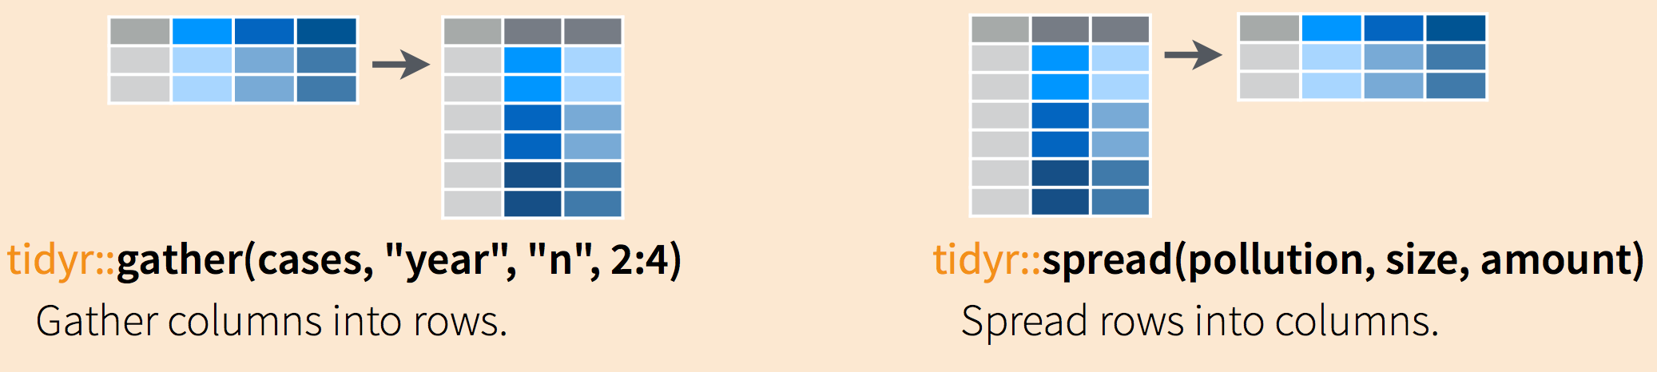
gather() and spread()
Notes:
https://jules32.github.io/2016-07-12-Oxford/dplyr_tidyr/

Slide 151
Tidy data is long data
Each variable is a column and contains values
Each observation is a row
Each type of observational unit forms a table
Patient | Temp | Med_A | Temp_A | Med_B | Temp_B
122030 | 37.0 | 300 | 37.1 | NA | NA
122021 | 38.2 | 200 | 38.1 | 85 | 36.5
124500 | 38.1 | 300 | 38.0 | NA | NA
126098 | 39.1 | NA | NA | 100 | 36.8

Slide 152
Wide and long data
# A tibble: 150 x 6
Species observation Petal.Length Petal.Width Sepal.Length Sepal.Width
<chr> <int> <dbl> <dbl> <dbl> <dbl>
1 setosa 1 1.40 0.200 5.10 3.50
2 setosa 2 1.40 0.200 4.90 3.00
3 setosa 3 1.30 0.200 4.70 3.20
4 setosa 4 1.50 0.200 4.60 3.10
5 setosa 5 1.40 0.200 5.00 3.60
6 setosa 6 1.70 0.400 5.40 3.90
7 setosa 7 1.40 0.300 4.60 3.40
8 setosa 8 1.50 0.200 5.00 3.40
9 setosa 9 1.40 0.200 4.40 2.90
10 setosa 10 1.50 0.100 4.90 3.10
# ... with 140 more rows
# A tibble: 600 x 4
Species observation measurement value
<chr> <int> <chr> <dbl>
1 setosa 1 Sepal.Length 5.10
2 setosa 1 Sepal.Width 3.50
3 setosa 1 Petal.Length 1.40
4 setosa 1 Petal.Width 0.200
5 setosa 2 Sepal.Length 4.90
6 setosa 2 Sepal.Width 3.00
7 setosa 2 Petal.Length 1.40
8 setosa 2 Petal.Width 0.200
9 setosa 3 Sepal.Length 4.70
10 setosa 3 Sepal.Width 3.20
# ... with 590 more rows
More information per row
Combines all measurements on a single individual
Necessary to plot matching measurements
More information per column
No values as column headers (tidy)
Single observation in single row (tidy)
Necessary to plot large amounts of data in a single plot

Slide 153
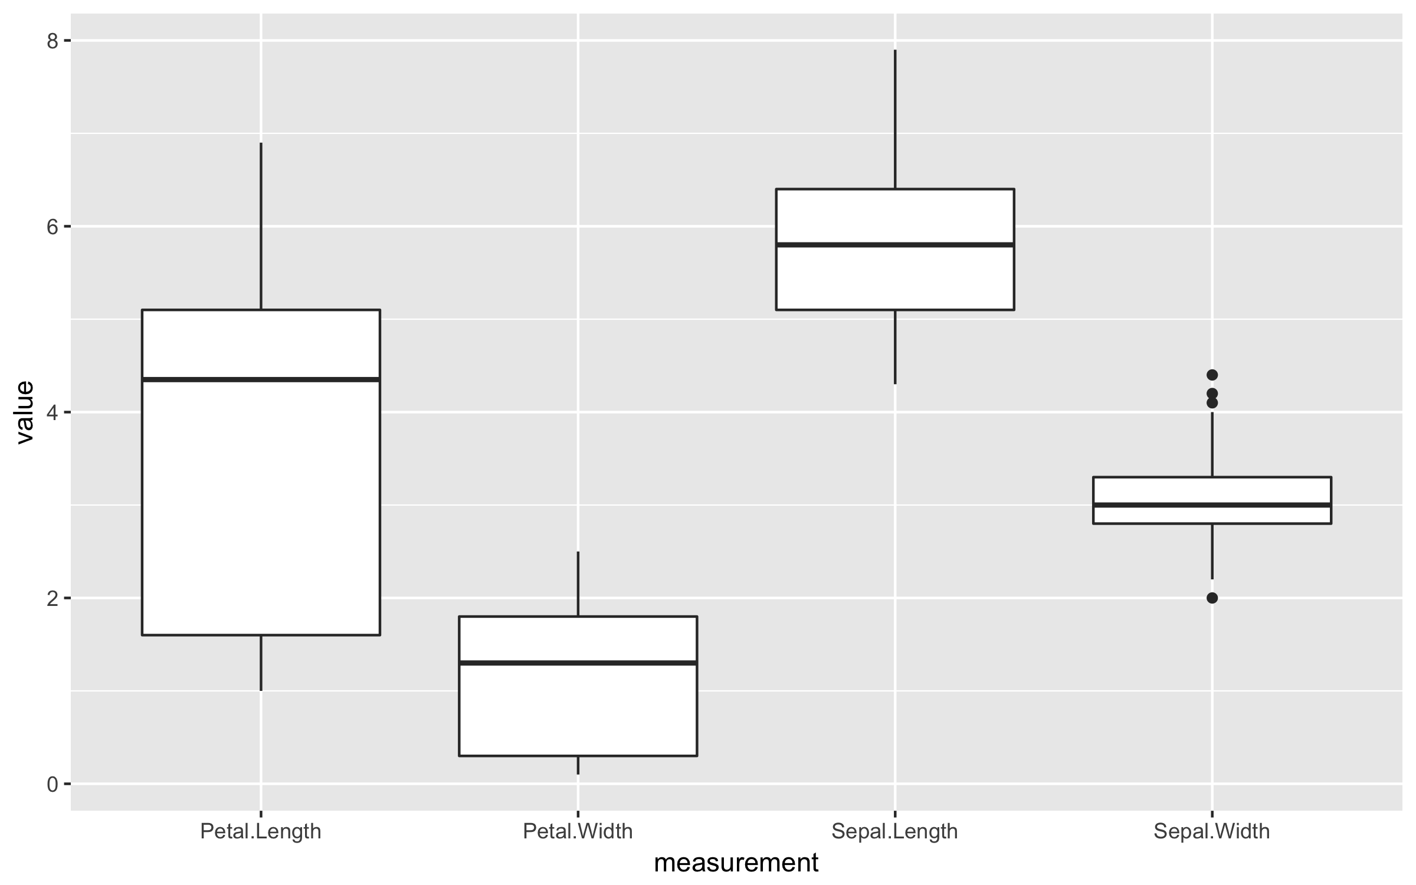
Wide vs. Long
More information per row
Combines all measurements on a single individual
Necessary to plot matching measurements
More information per column
No values as column headers (tidy)
Single observation in single row (tidy)
Necessary to plot large amounts of data in a single plot

Slide 154
Function: gather()
> iris_obs <- mutate(iris, observation = 1:n())
> iris_obs
# A tibble: 150 x 6
Sepal.Length Sepal.Width Petal.Length Petal.Width Species observation
<dbl> <dbl> <dbl> <dbl> <chr> <int>
1 5.10 3.50 1.40 0.200 setosa 1
2 4.90 3.00 1.40 0.200 setosa 2
3 4.70 3.20 1.30 0.200 setosa 3
4 4.60 3.10 1.50 0.200 setosa 4
5 5.00 3.60 1.40 0.200 setosa 5
6 5.40 3.90 1.70 0.400 setosa 6
7 4.60 3.40 1.40 0.300 setosa 7
8 5.00 3.40 1.50 0.200 setosa 8
9 4.40 2.90 1.40 0.200 setosa 9
10 4.90 3.10 1.50 0.100 setosa 10
# ... with 140 more rows
headers
content

Slide 155
Function: gather()
> iris_obs <- mutate(iris, observation = 1:n())
> iris_obs
> iris_long <- gather(iris_obs, measurement, value, Sepal.Length, Sepal.Width, Petal.Length, Petal.Width)
> iris_long
# A tibble: 600 x 4
Species observation measurement value
<chr> <int> <chr> <dbl>
1 setosa 1 Sepal.Length 5.10
2 setosa 1 Sepal.Width 3.50
3 setosa 1 Petal.Length 1.40
4 setosa 1 Petal.Width 0.200
5 setosa 2 Sepal.Length 4.90
6 setosa 2 Sepal.Width 3.00
7 setosa 2 Petal.Length 1.40
8 setosa 2 Petal.Width 0.200
9 setosa 3 Sepal.Length 4.70
10 setosa 3 Sepal.Width 3.20
# ... with 590 more rows
headers
content

Slide 156
Function: spread()
column to
headers
column to be split
as content
> iris_wide <- spread(iris_long, measurement, value)
> iris_wide
# A tibble: 150 x 6
Species observation Petal.Length Petal.Width Sepal.Length Sepal.Width
<chr> <int> <dbl> <dbl> <dbl> <dbl>
1 setosa 1 1.40 0.200 5.10 3.50
2 setosa 2 1.40 0.200 4.90 3.00
3 setosa 3 1.30 0.200 4.70 3.20
4 setosa 4 1.50 0.200 4.60 3.10
5 setosa 5 1.40 0.200 5.00 3.60
6 setosa 6 1.70 0.400 5.40 3.90
7 setosa 7 1.40 0.300 4.60 3.40
8 setosa 8 1.50 0.200 5.00 3.40
9 setosa 9 1.40 0.200 4.40 2.90
10 setosa 10 1.50 0.100 4.90 3.10
# ... with 140 more rows
necessary for grouping!

Slide 157
Exercises
Please do basic exercises 3-I and 3-II.
Time left? Opt for a reading exercise or optional exercise!

Slide 158
All done? Time to knit!

Slide 159
Introduction to R & data
Before you leave…

Slide 160
Other RDM workshops
https://www.uu.nl/en/research/research-data-management/tools-services/training-and-workshops
Learn to write your Data Management Plan (online course)
Quickstart to Research Data Management

Slide 161
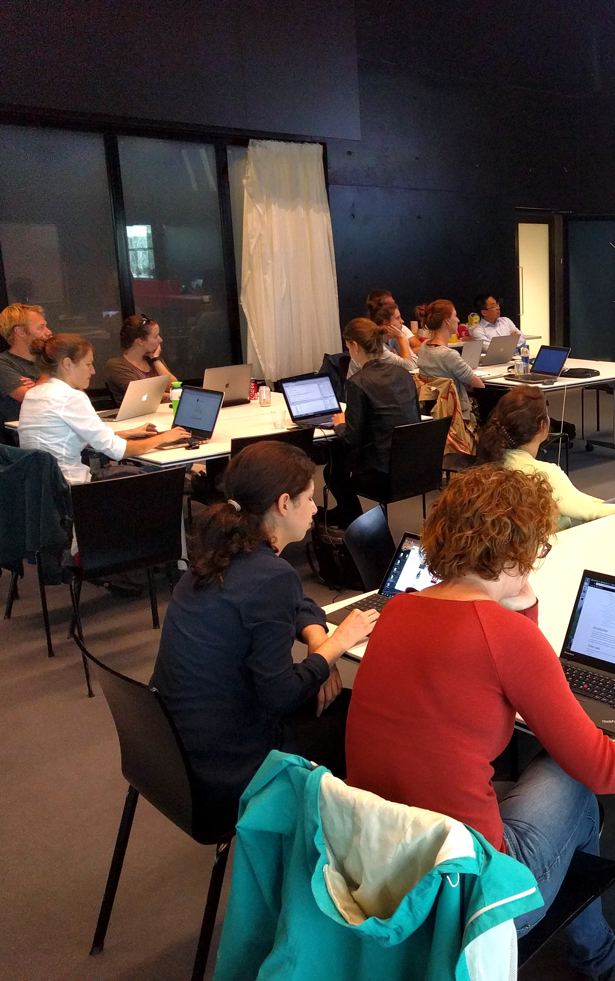
R Cafe
Monthly event for R programmers at UU/UMCU. Be part of the R community! Work on your own project, and ask (or answer!) questions.
More info on:
github.com/UtrechtUniversity/R-data-cafe
(Or subscribe to the newsletter, check the RDM support website…)
Mondays, 15-17, Bucheliuszaal (6.18) UB
Next edition: Monday 15/4, 15:00-17:00

Slide 162
We love feedback! It’s how we learn…
Please send your feedback, remarks, questions to Barbara: b.m.i.vreede@uu.nl
Or generate an issue on github!
tinyurl.com/introRData

Slide 163
useR <- function(){
print("Good luck and see you!")
}
useR()

